Slide 1
Applying Collective Impact to a Healthy Start CAN/CI Initiative
Peer Learning Network Call #2
July 2015

Slide 2
Agenda
Welcome
Today’s Objectives
Wrap- In
Outstanding Questions
CI Mindset Shifts
Check-in on Between Now & Then Activities
Overview Collective Impact Pre-conditions
Share and Discuss Tools for Assessing CI Readiness
Between Now & Then Activities (aka next call)
Wrap-Up

Slide 3
CI-PLN Roadmap
Session | Monthly Call Focus
1 | Building Relationships & PLN Goal Setting
2 | Exploring the CI Pre-Conditions
3 | Common Agenda
4 | Shared Measurement
5 | Mutually Reinforcing Activities
6 | Continuous Communications & Backbone Infrastructure
7 | Year 1 Collective Impact Implementation Plans
8 | Reflecting On Our Learning Journey

Slide 4
Today’s Call Objectives
Revisit outstanding items from last month’s call.
Explain the pre-condition of collective impact.
Share tools for assessing your CAN’s alignment with the pre-conditions for a successful CI effort.

Slide 5
Creating a Safe Space
We agree to:
Listen with attention
Speak with intention
Contribute to the well-being of the group
We commit to:
Keep the stories we share in our community confidential
Listening with compassion and curiosity
Asking each other for what we need and offer what we can
Pausing, from time to time, to re-gather our thoughts or focus

Slide 6
Wrap-In

Slide 7
Outstanding Questions from Call #1
What does a good agenda look like? - agenda template Do you use a standard template? What are key things that you find helpful to include on your template?
Timeline for progress, what is reasonable and realistic?
Moving from Consortium to CANs: Do we start all over? How do we transition?
What is the difference between the Consortium and the CAN?

Slide 8
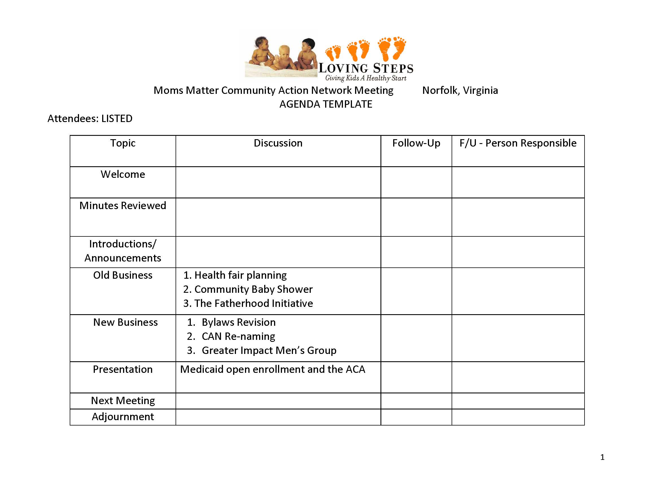
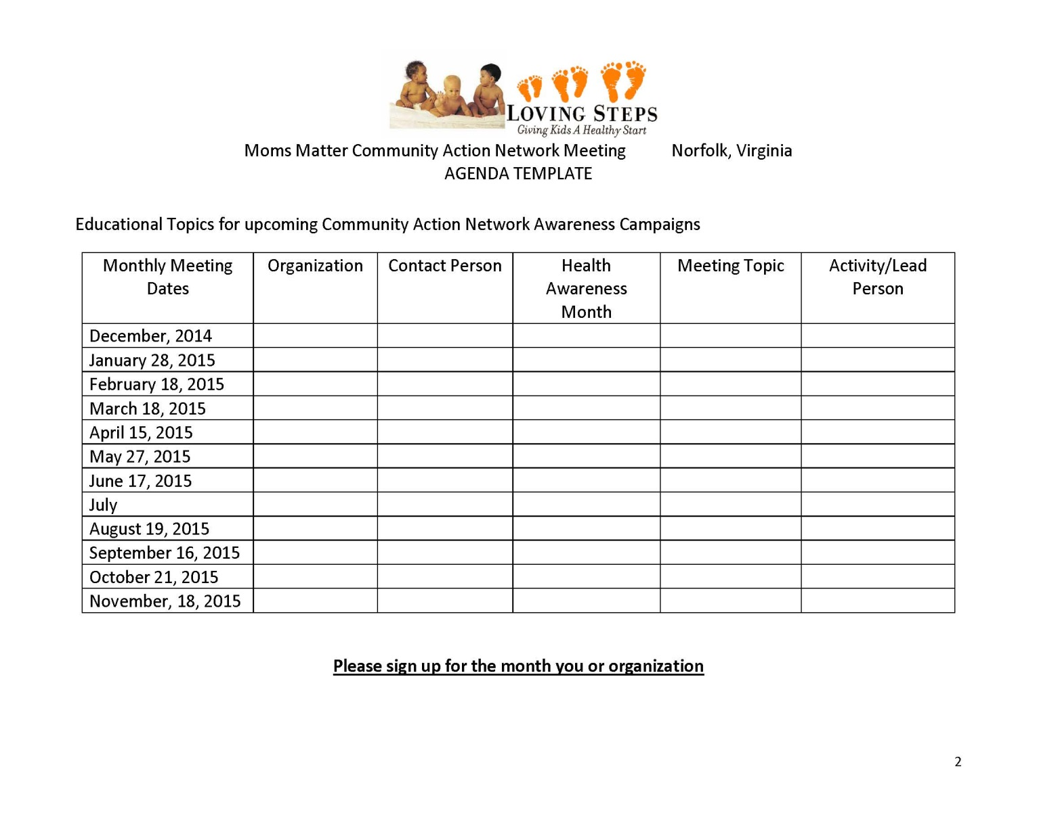
Sample Agenda Templates

Slide 9
Outstanding Questions from Call #1
What does a good agenda look like? - agenda template Do you use a standard template? What are key things that you find helpful to include on your template?
Timeline for progress, what is reasonable and realistic?
Moving from Consortium to CANs: Do we start all over? How do we transition?
What is the difference between the Consortium and the CAN?

Slide 10
Outstanding Questions from Call #1
What does a good agenda look like? - agenda template Do you use a standard template? What are key things that you find helpful to include on your template?
Timeline for progress, what is reasonable and realistic?
Moving from Consortium to CANs: Do we start all over? How do we transition?
What is the difference between the Consortium and the CAN?

Slide 11
Collective Impact Mindset Shifts
Buy-in
Programs
Content
Positional Leadership
Ownership
Systems
Context
Shared and Adaptive Leadership

Slide 12
Group Discussion
What are your thoughts about this definition of buy-in and ownership?

Slide 13
Group Discussion
What strategies are you employing to ensure that your CAN/CI initiative is addressing systems change vs. program outcomes?

Slide 14
Group Discussion
How are you ensuring that the context expertise is being thoughtfully & meaningfully integrated with the content expertise?

Slide 15
Group Discussion
In what ways are you using a shared or adaptive leadership approach?

Slide 16
Overview of Collective Impact Pre-Conditions & Tools to Address Them

Slide 17
Pre-conditions of Collective Impact
Influential Champion(s)
Influential stakeholders that are already engaged in CAN
Who are the champions that should be engaged in your CAN?
Organizational and Individuals
Suggested Tool: Top 100 Partner Tool and Stakeholder Engagement Wheel Worksheet
Urgency of Issue
Conduct a formal or informal environmental scan of priority issues impacting your CAN
Suggested Tool: Assessing Our Community Context & Assessing Readiness for CI
Adequate Resources
Does your CAN have the necessary inputs to take action?
Suggested Tool: Assessing our CI Resources

Slide 18
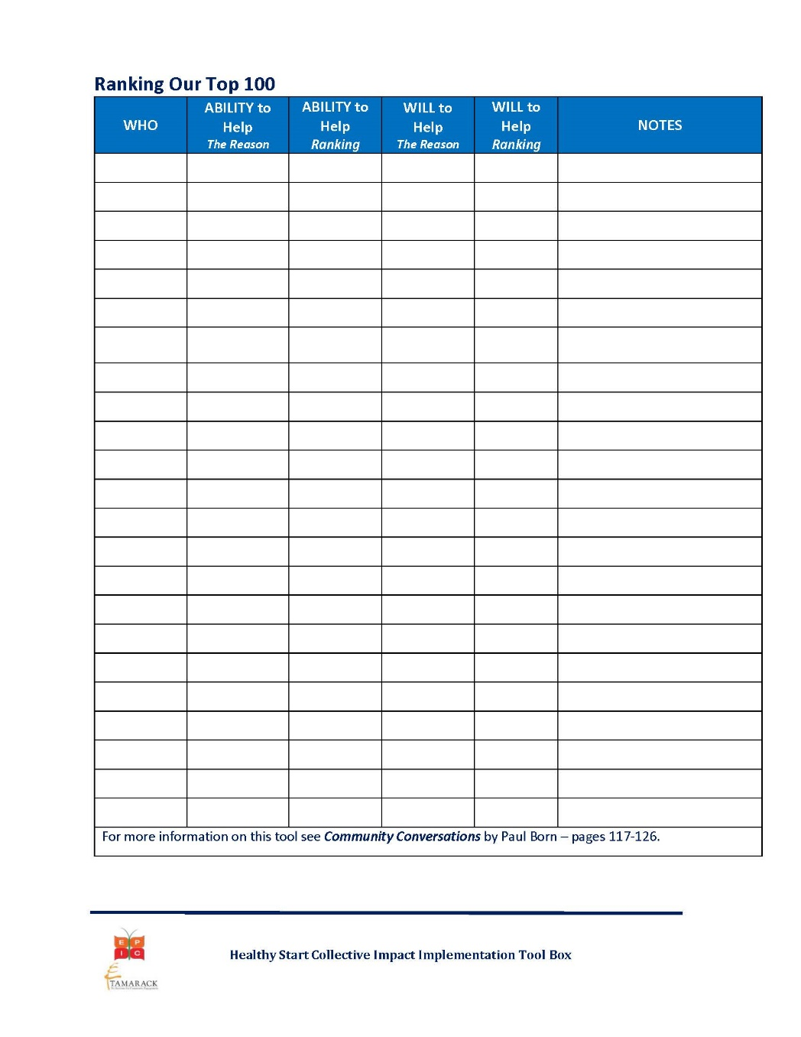
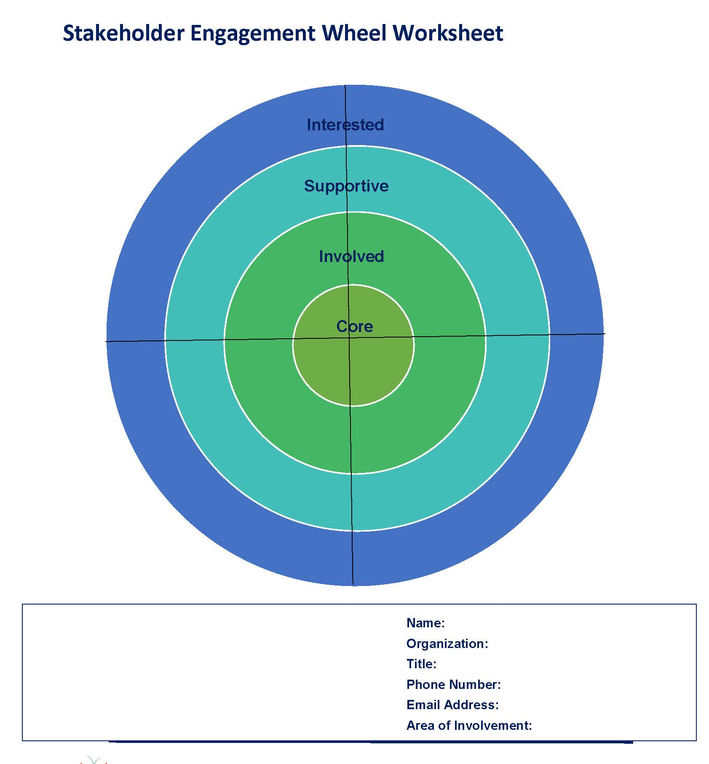
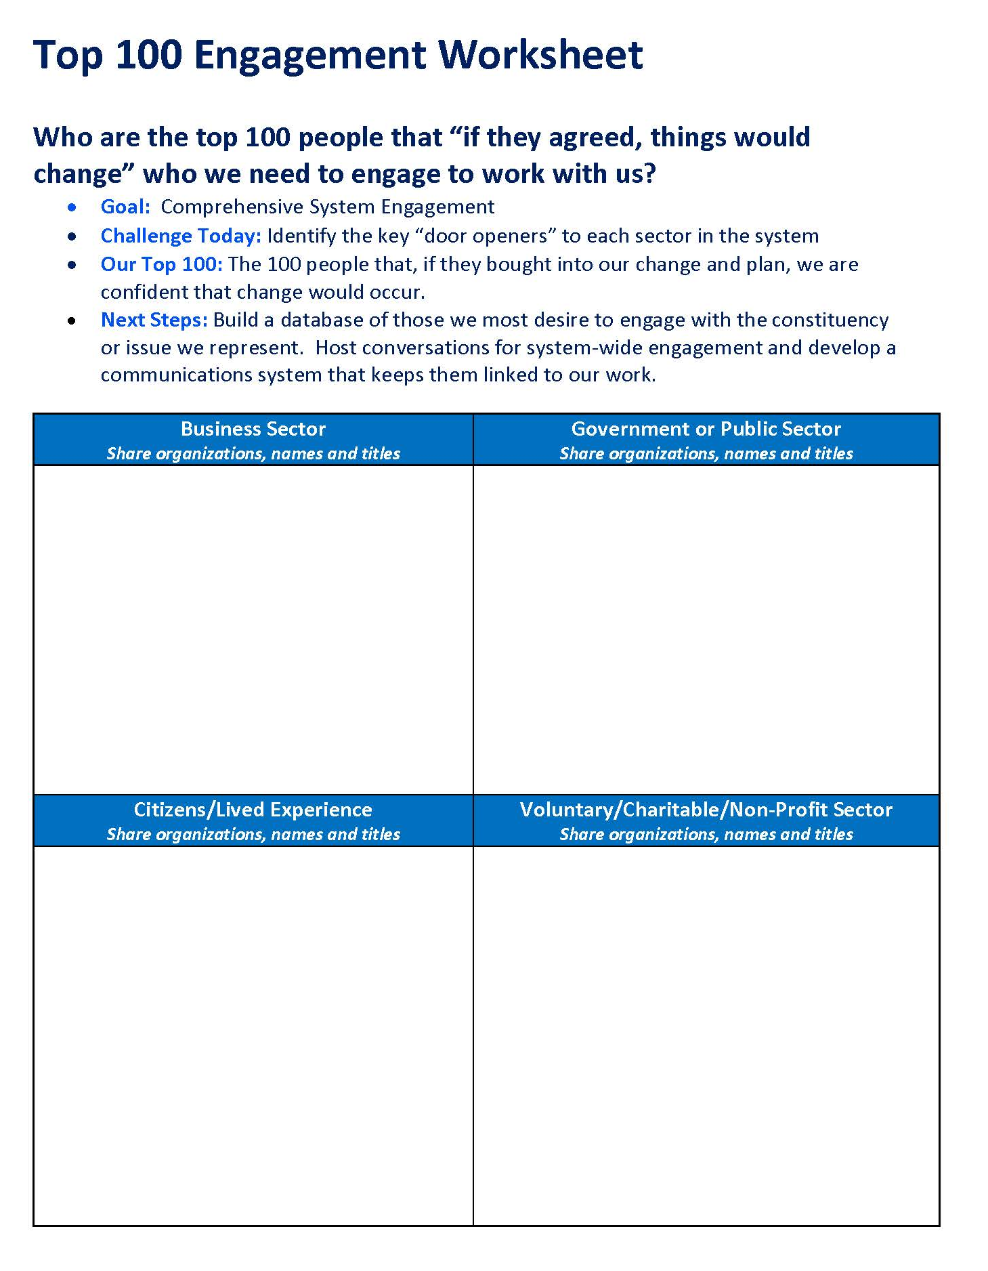
Tools – Influential Champion(s)
Suggested Tool: Top 100 Partner Tool

Slide 19
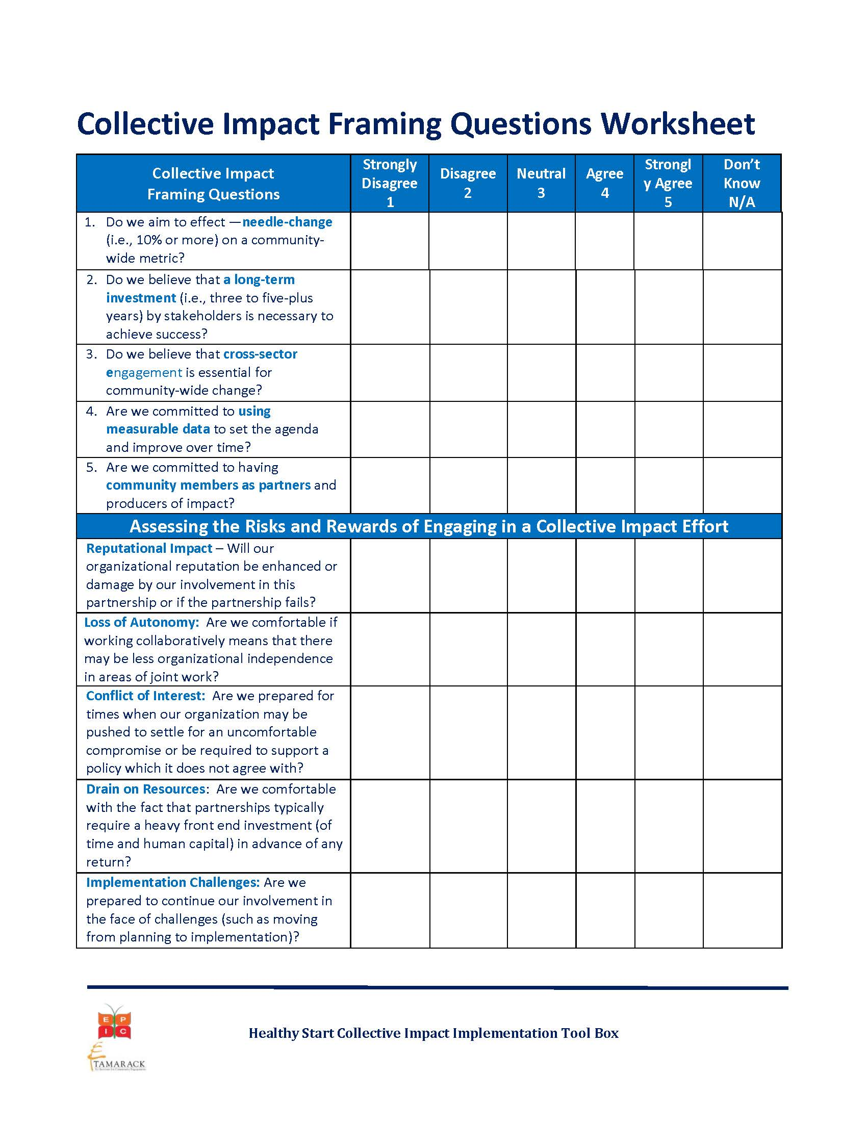
Tools – Urgency of Issue

Slide 20
Tools – Adequate Resources

Slide 21
Questions & Reflections?
Questions?
Thoughts or reflections?

Slide 22
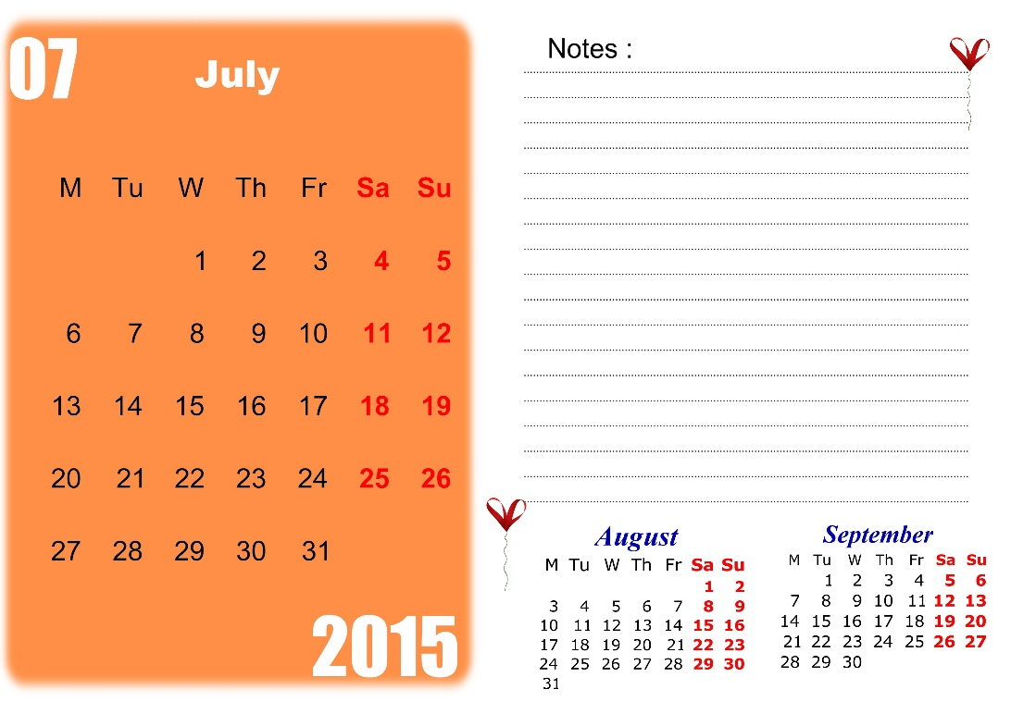
Between Now & Then (aka next call)
Register and share profile info on forum
Start and/or respond to a discussion thread on the forum
Apply at least one tool shared during the last two calls
Email Kim agenda template examples and MOU examples

Slide 23
Next CI PLN Call: Common Agenda August 2015

