Slide 1
Applying Collective Impact to a Healthy Start CAN/CI Initiative
Peer Learning Network Call #8
Backbone and Reflection
January 2016

Slide 2
Agenda
Welcome
Check-In
Wrap –In
Action Planning
Review Template
Overview of Backbone Support
Reflections and your next steps
Wrap-up & Next Steps

Slide 3
Where have we been… CI-PLN Roadmap
Session | Monthly Call Focus
1 | Building Relationships & PLN Goal Setting
2 | Exploring the CI Pre-Conditions
3 | Common Agenda
4 | Shared Measurement
5 | Mutually Reinforcing Activities
6 | Year 1 Collective Impact - Action Plans (Face to Face!)
7 | Recap Action Planning & Continuous Communications
8 | Backbone Function & Reflecting On Our Learning Journey

Slide 4
Objectives
Introduce and discuss CI Condition Backbone Support
Introduce and discuss tool that will help CAN/CI Initiatives begin to explore this condition
Share reflections and next steps to closeout initial CI-PLN series

Slide 5
Creating a Safe Space
We agree to:
Listen with attention
Speak with intention
Contribute to the well-being of the group
We commit to:
Keep the stories we share in our community confidential
Listening with compassion and curiosity
Asking each other for what we need and offer what we can
Pausing, from time to time, to re-gather our thoughts or focus

Slide 6
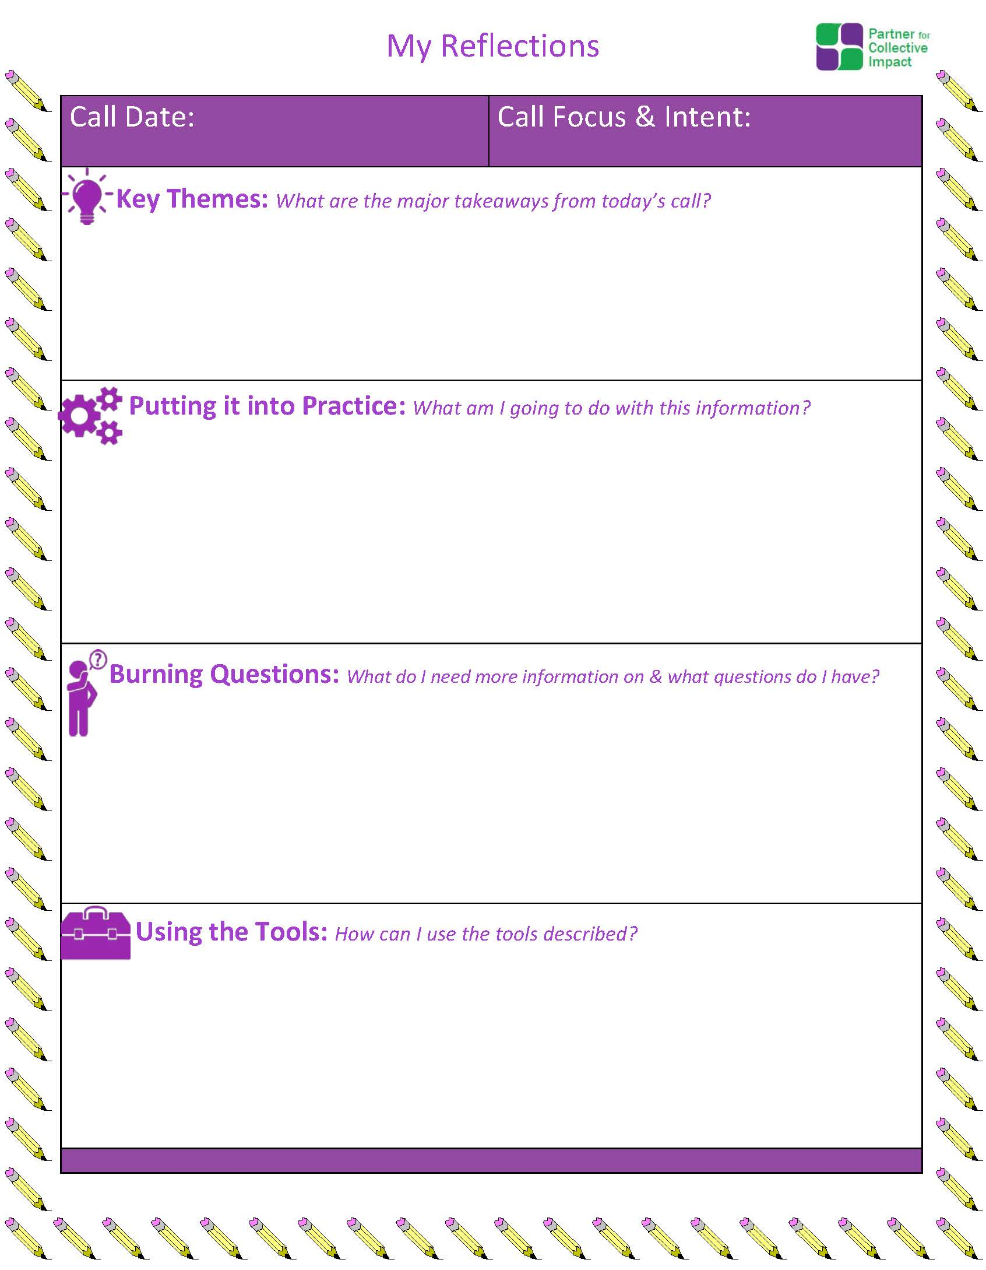
Reminder: Post Call Reflection Tool

Slide 7
Check – In
What other CI resources have you found helpful?

Slide 8
Backbone Support

Slide 9
The Five Conditions of Collective Impact
Common Agenda
All participants have a shared vision for change including a common understanding of the problem and a joint approach to solving it through agreed upon actions
Shared Measurement
Collecting data and measuring results consistently across all participants ensures efforts remain aligned and participants hold each other accountable
Mutually Reinforcing Activities
Participant activities must be differentiated while still being coordinated through a mutually reinforcing plan of action
Continuous Communication
Consistent and open communication is needed across the many players to build trust, assure mutual objectives, and appreciate common motivation
Backbone Support
Creating and managing collective impact requires a dedicated staff and a specific set of skills to serve as the backbone for the entire initiative and coordinate participating organizations and agencies
Source: FSG

Slide 10
Collective Impact Forum – Backbone Toolkit

Slide 11
Backbone Role
Maintain overall…
Strategy coordination
Management of day to day operations
Implementation of stakeholder communications and data collection and sharing
Source: FSG and Tamarack

Slide 12
Group Discussion
What backbone function/support does your organization provide to the CAN?
Do stakeholders in the community perceive you as a backbone?

Slide 13
Types of Backbone Activities
Strategic – oversight, external communication, research, evaluation and policy
Logistical – logistical support, internal communication, note-taking , scheduling
Source: FSG and Tamarack

Slide 14
Backbone Activities Examples
• Knowledge Sharing
• Logistical Support
• Coordinate Steering committees
• Support Fundraising
• Communication and Outreach
• Establish and Support Working Groups
• Project Management and Facilitation
• Evaluation and Guidance
Source: FSG and Tamarack

Slide 15
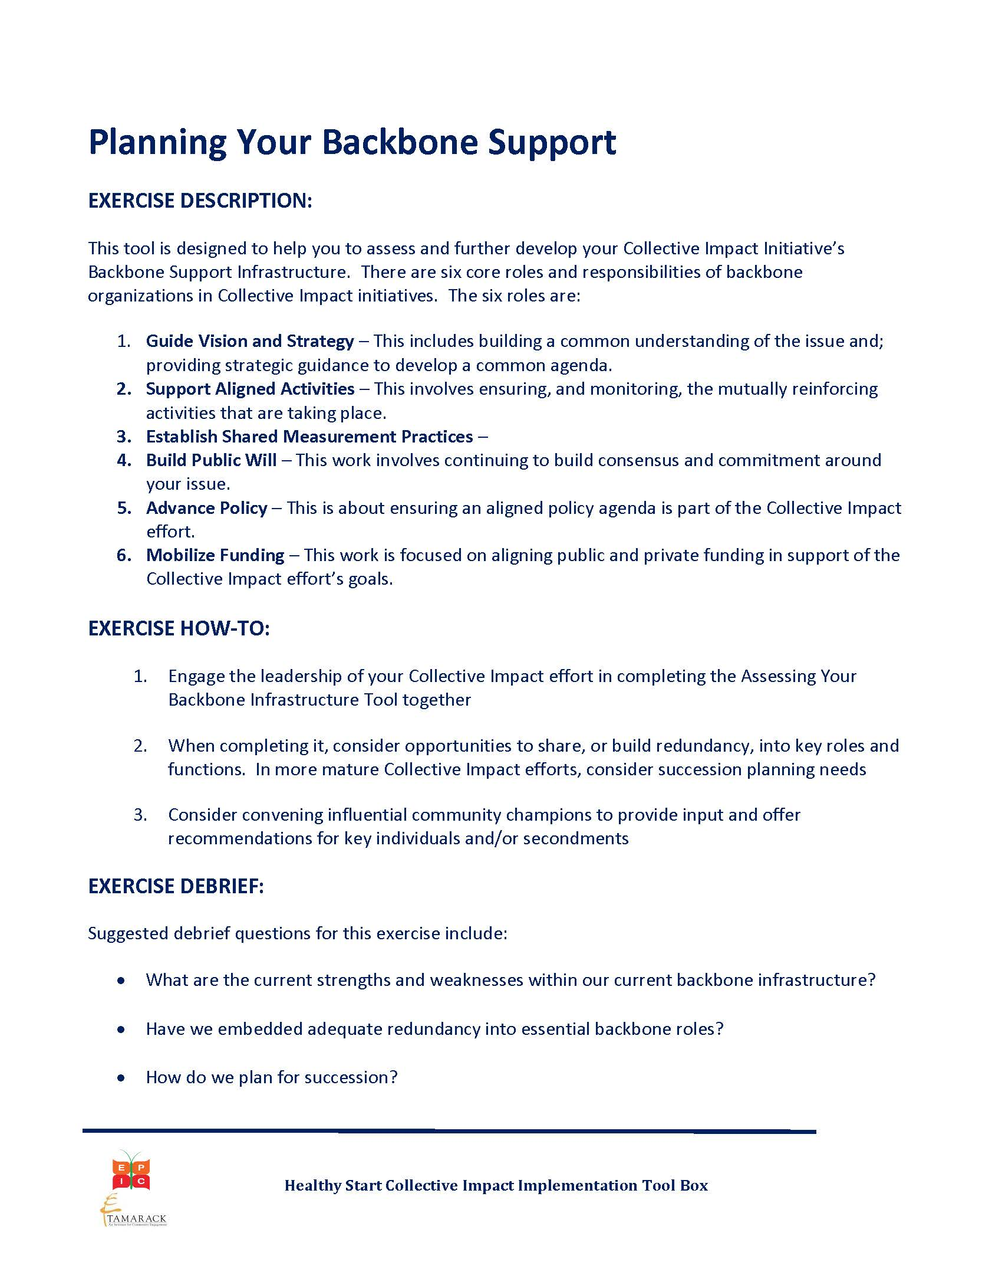
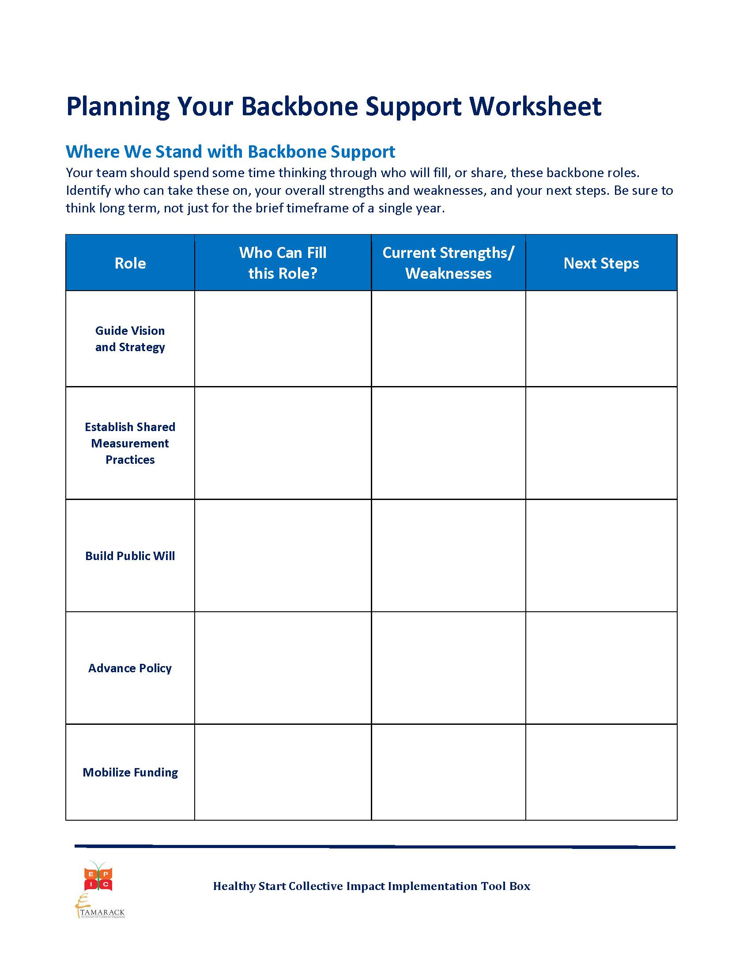
Backbone Tool: Planning Your Backbone Support

Slide 16
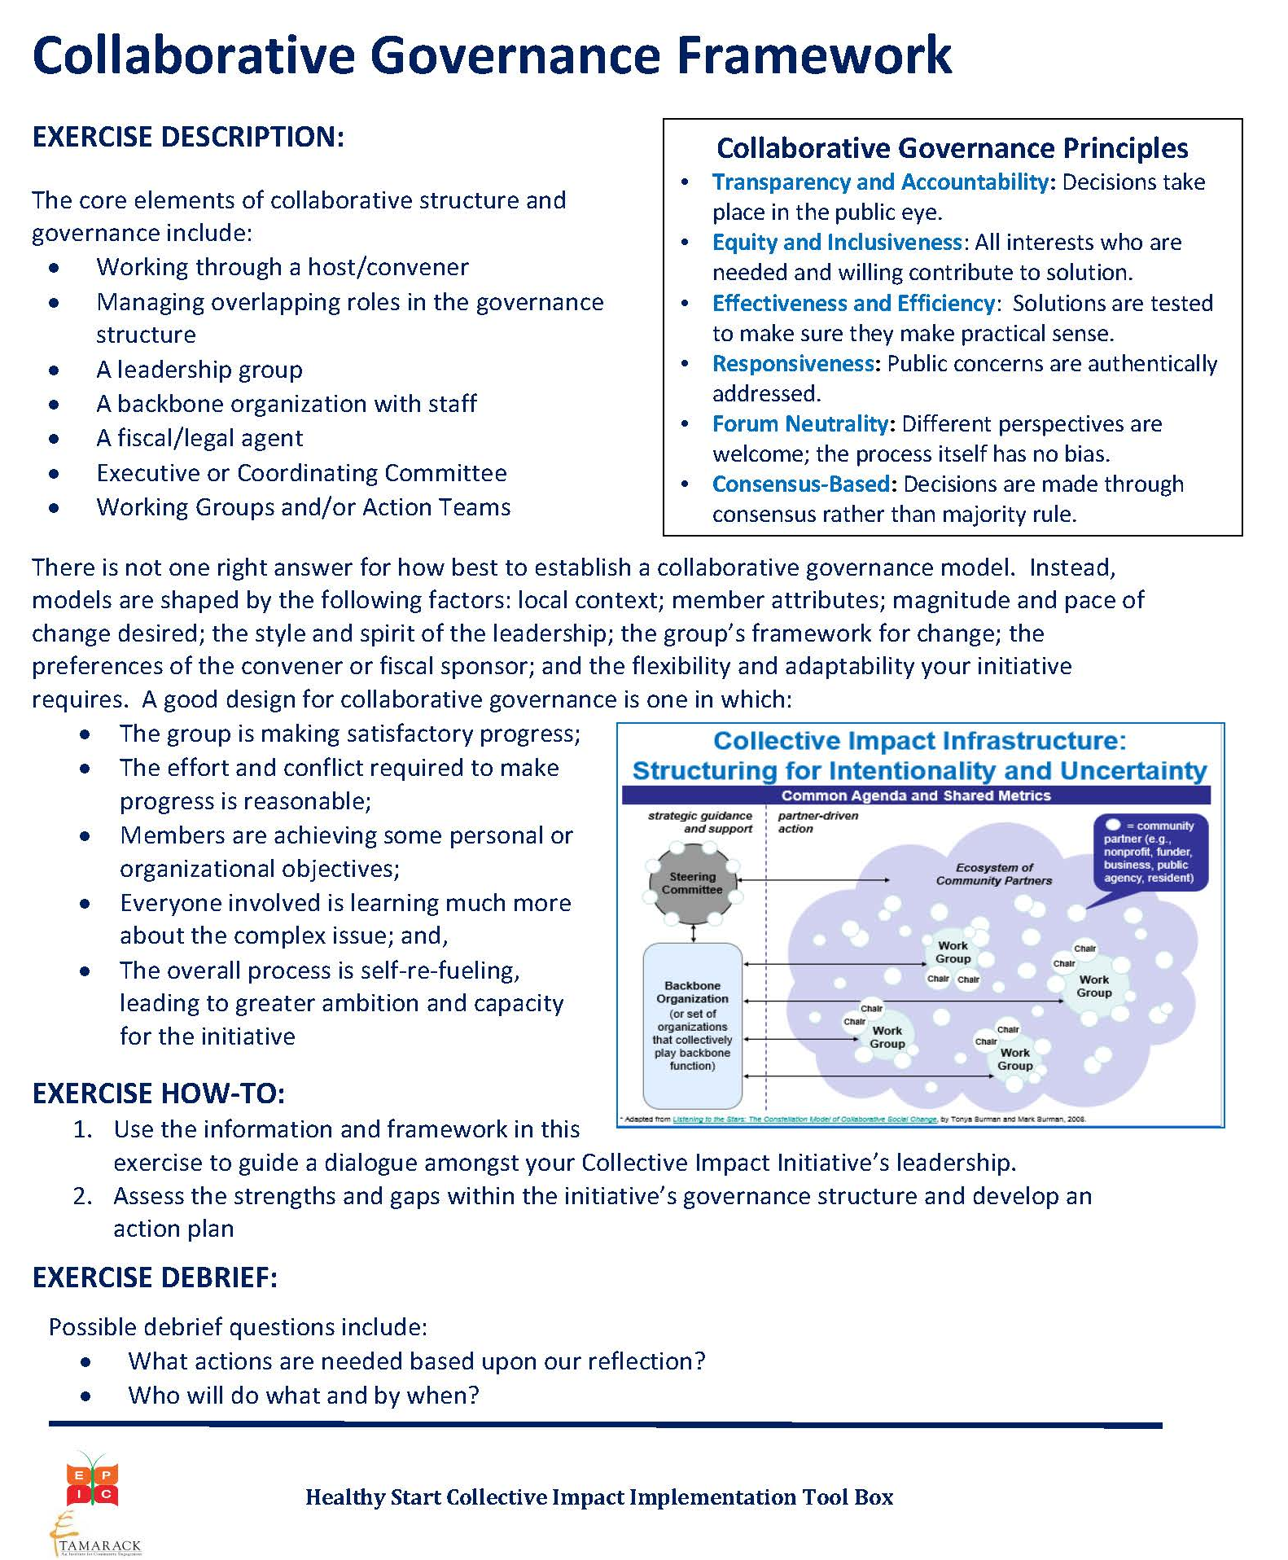
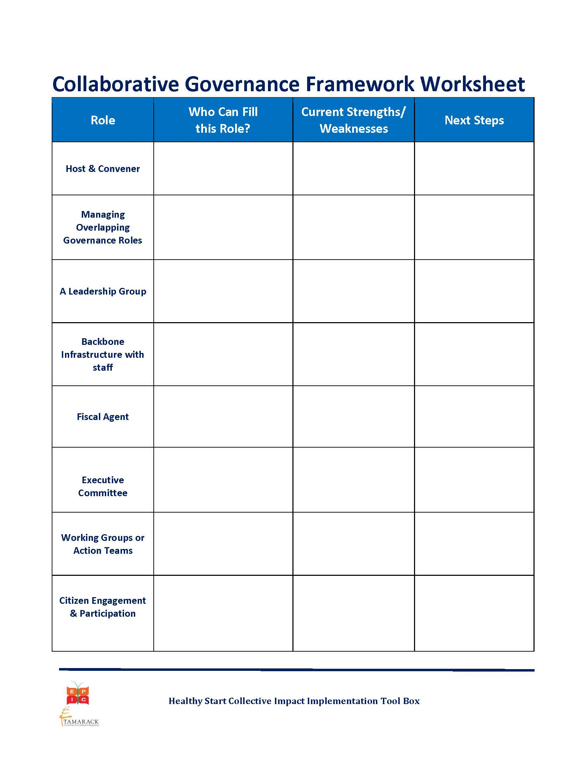
Backbone Tool: Collaborative Governance Framework

Slide 17
Member Reflection and Sharing Next Steps

Slide 18
Group Discussion
Please describe your most important accomplishments or major successes relating to your CAN/CI initiative in the last 8 months.
How has participating in the CI-PLN helped you progress in your CAN efforts/CI initiative?
Please describe any tools, information, and/or discussions during the calls that have helped you to move your CAN/CI efforts forward.

Slide 19
Group Discussion
What are your next steps in implementing CI and working with your CAN? Briefly describe your plans for the next 6 months.

Slide 20
Next Steps & Wrap Up
Working to get the entire toolkit, slide decks, other resources in one central location on EPIC website.
Reminder: If you would like more individualized TA related to your CAN or CI Initiative please visit the Healthy Start EPIC website to submit a TA request.
In-person CI PLN celebration at the NHSA Spring Conference on Sunday evening from 5-6:30pm
Next CI-PLN Series: CI-PLN - Level 1 Grantees and CI-PLN for Evaluators. More being considered. We always welcome feedback and suggestions!

Slide 21
Check – In
Who is coming to the NHSA Conference?
Who would be willing to share your successes and reflections?
CI-PLN Celebration
Sunday February 28th
5:00 – 6:15

Slide 22
Up Next: CI-PLN Celebration February 28, 2016 NHSA Conference
5:00 - 6:15 PM EST

