Slide 1
“Live” CI-PLN
Healthy Start Convention
November 16, 2015

Slide 2
Community Action Network – Action Plan Template
Optional Planning Template/Tool

Slide 3
About the CAN Action Plan Template/Tool
Template is optional
Purpose is to consider progress to date and plan for the next 12 months
Organize and think through your CAN/CI efforts
With the help of Tamarack, the CI-PLN Co-Facilitators adapted FSG’s Phases of Collective Impact document and then used that as a frame for the template
We are interested in hearing your feedback and suggestions as you use the template. Just as CI is adaptive, so is the template
Communicating your CI Journey

Slide 4
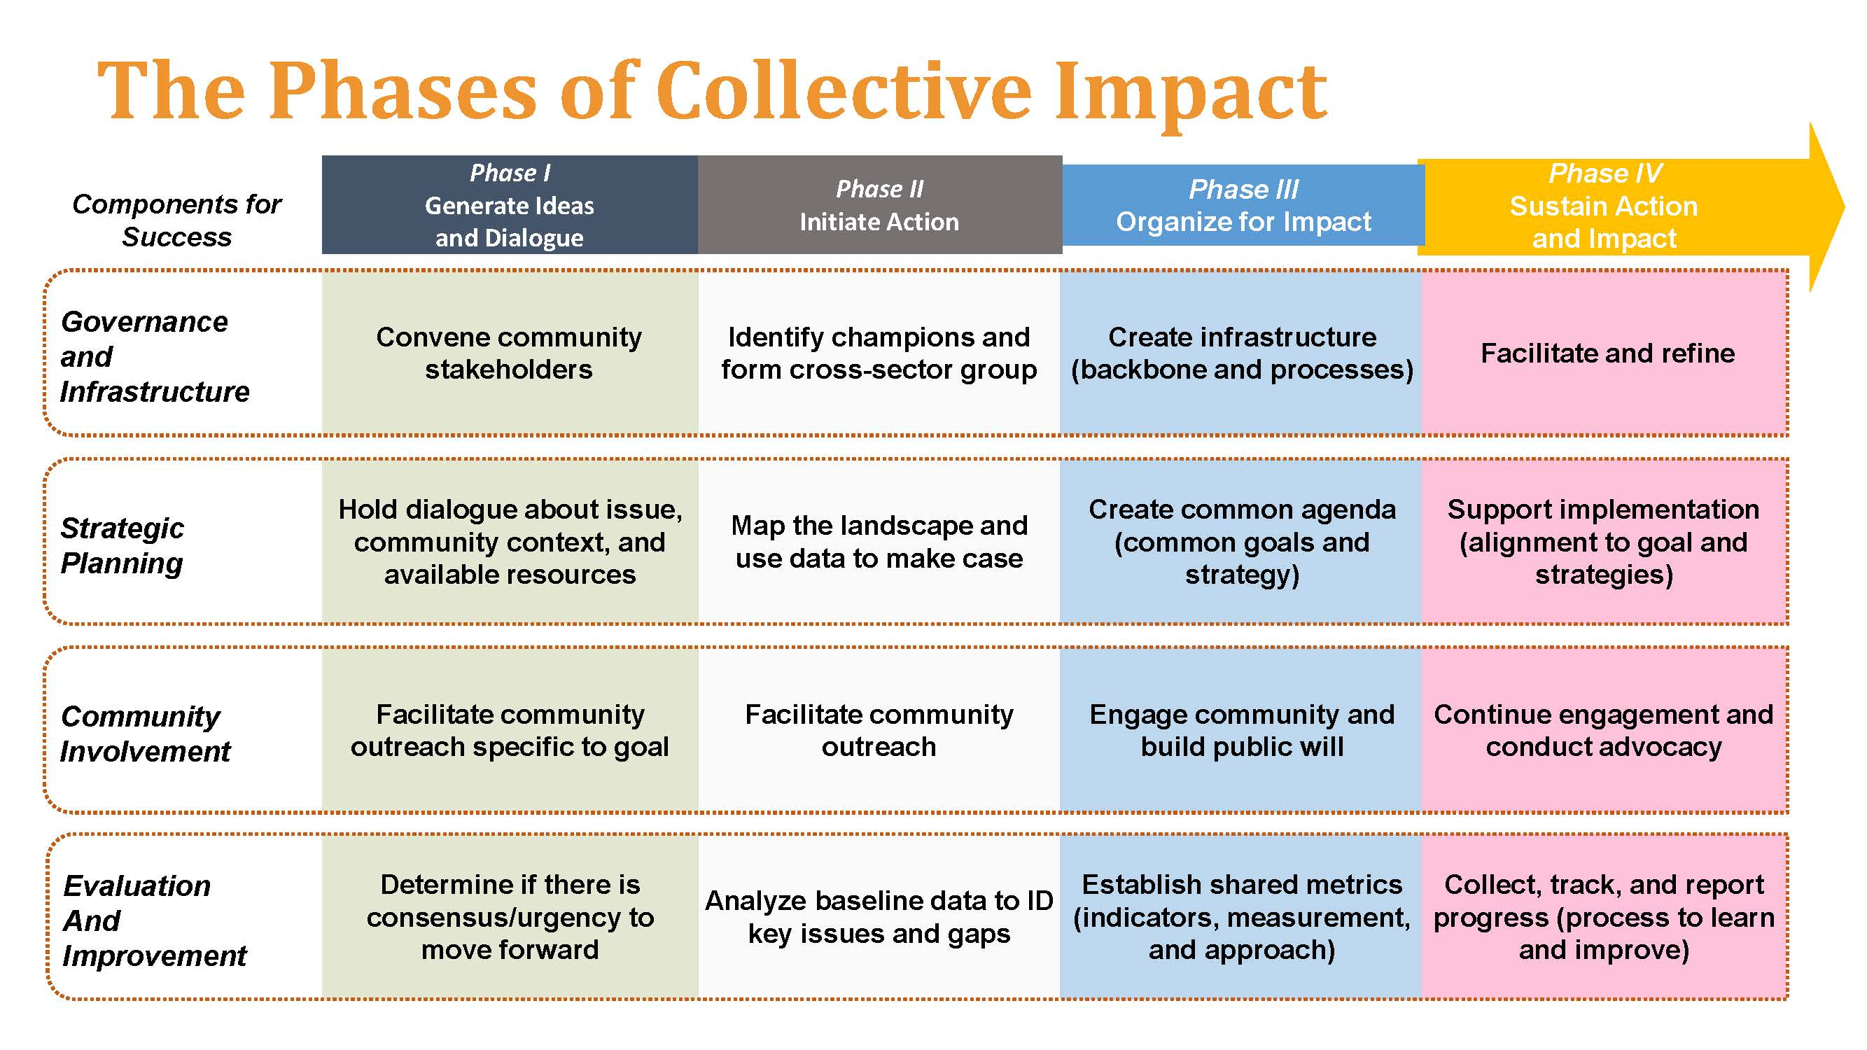
FSG’s Phases with Tamarack’s Additions
Notes:
This is the original document that FSG developed a few years ago. There are a few important things to note
This document is suggesting that there are 4 phases of Collective Impact – see across the top.
It also suggest that there are 4 components of success to CI – see them running down the left-hand side of the table –
Another important note: Although we have structured our PLN roadmap in a pretty linear way by focusing on a condition each call, that is not how CI rolls out in reality. Instead the pre-conditions and/or conditions are occurring simultaneously throughout the phases. For this we felt that using the phases of CI as a frame rather than creating a template that focused on planning each condition would make for a more realistic and helpful way to think through planning the next 12 months

Slide 5
The Phases of Collective Impact
Over-arching Actions | Components of Success | Phase I Generate Ideas and Host Dialogues | Phase II Initiate Action | Phase III Organize for Impact | Phase IV Sustain Action and Impact
 |  | Pre start-up Focus: Engagement and Exploration | Start up Focus: From Idea to Formation | Growth Focus: Experimentation and Growth | Maturity Focus: Sustain and Renew
 |  | EARLY YEARS Key Question: What needs to happen? |  | MIDDLE YEARS Key Question: How well is it working? | LATER YEARS Key Question: What difference are we making?
 |  | KEY ELEMENTS
Design, Implement and Lead your CI Initiative | Governance and Infrastructure How decisions are made and responsibilities shared | Convene Community Stakeholders | Identify champions and form cross-sector group | Create infrastructure (backbone and processes) | Facilitate, refine and renew
 | Strategic Planning What are we trying to do and how: Our Theory of Change | Hold dialogue about issue, community context and available resources | Map the landscape and use data to make the case | Create common agenda (shared goals and strategy) | Support implementation (alignment to goal and strategies)
Understand Context | Community Involvement Who is involved? Who else’s eyes need to be on this issue? | Facilitate community outreach specific to goal | Facilitate community outreach | Engage community and build public will | Continue engagement and conduct advocacy
Assess Progress, Outcomes, Impact and Learning | Evaluation and Improvement What are we learning and how are we changing culture, norms and systems? | Determine if there is consensus and urgency to move forward | Analyze baseline data to ID key issues and gaps | Establish shared metrics (indicators, measurement and approach) | Collect, track and report progress (process to learn and improve)
Notes:
Here is our version of the Phases of CI
Let’s Unpack this document

Slide 6
The Phases of Collective Impact
Over-arching Actions | Components of Success | Phase I Generate Ideas and Host Dialogues | Phase II Initiate Action | Phase III Organize for Impact | Phase IV Sustain Action and Impact
 |  | Pre start-up Focus: Engagement and Exploration | Start up Focus: From Idea to Formation | Growth Focus: Experimentation and Growth | Maturity Focus: Sustain and Renew
 |  | EARLY YEARS Key Question: What needs to happen? |  | MIDDLE YEARS Key Question: How well is it working? | LATER YEARS Key Question: What difference are we making?
 |  | KEY ELEMENTS
Design, Implement and Lead your CI Initiative | Governance and Infrastructure How decisions are made and responsibilities shared | Convene Community Stakeholders | Identify champions and form cross-sector group | Create infrastructure (backbone and processes) | Facilitate, refine and renew
 | Strategic Planning What are we trying to do and how: Our Theory of Change | Hold dialogue about issue, community context and available resources | Map the landscape and use data to make the case | Create common agenda (shared goals and strategy) | Support implementation (alignment to goal and strategies)
Understand Context | Community Involvement Who is involved? Who else’s eyes need to be on this issue? | Facilitate community outreach specific to goal | Facilitate community outreach | Engage community and build public will | Continue engagement and conduct advocacy
Assess Progress, Outcomes, Impact and Learning | Evaluation and Improvement What are we learning and how are we changing culture, norms and systems? | Determine if there is consensus and urgency to move forward | Analyze baseline data to ID key issues and gaps | Establish shared metrics (indicators, measurement and approach) | Collect, track and report progress (process to learn and improve)
Notes:
1st in trying to wrap our heads around the intention and purpose of the components of success we felt that looking at the actions that are associated with these components can be broken down as follows: (read the over-arching actions)
There is a relationship between the overarching actions and each of the components of success. For example: the design, implementation, and leading the initiative directly speaks to the governance and infrastructure and strategic planning that must occur.
Let’s look a bit closer at the components: read

Slide 7
The Phases of Collective Impact
Over-arching Actions | Components of Success | Phase I Generate Ideas and Host Dialogues | Phase II Initiate Action | Phase III Organize for Impact | Phase IV Sustain Action and Impact
 |  | Pre start-up Focus: Engagement and Exploration | Start up Focus: From Idea to Formation | Growth Focus: Experimentation and Growth | Maturity Focus: Sustain and Renew
 |  | EARLY YEARS Key Question: What needs to happen? |  | MIDDLE YEARS Key Question: How well is it working? | LATER YEARS Key Question: What difference are we making?
 |  | KEY ELEMENTS
Design, Implement and Lead your CI Initiative | Governance and Infrastructure How decisions are made and responsibilities shared | Convene Community Stakeholders | Identify champions and form cross-sector group | Create infrastructure (backbone and processes) | Facilitate, refine and renew
 | Strategic Planning What are we trying to do and how: Our Theory of Change | Hold dialogue about issue, community context and available resources | Map the landscape and use data to make the case | Create common agenda (shared goals and strategy) | Support implementation (alignment to goal and strategies)
Understand Context | Community Involvement Who is involved? Who else’s eyes need to be on this issue? | Facilitate community outreach specific to goal | Facilitate community outreach | Engage community and build public will | Continue engagement and conduct advocacy
Assess Progress, Outcomes, Impact and Learning | Evaluation and Improvement What are we learning and how are we changing culture, norms and systems? | Determine if there is consensus and urgency to move forward | Analyze baseline data to ID key issues and gaps | Establish shared metrics (indicators, measurement and approach) | Collect, track and report progress (process to learn and improve)
Notes:
The four phase are broken down as follows (read top line)
Enter – next line read
Enter – we thought it is helpful to have a sense of the timing related to the phases. CI doesn’t occur over night. At the heart it, it is about relationships, trust, and establishing a process for working very intentionally together. All of which takes time.
As you can see phase I and II occurs in the early years (1 to 2 years), read key question
Middle Years (2 to 3)
LATER Years ( 4 to 5)

Slide 8
The Phases of Collective Impact
Over-arching Actions | Components of Success | Phase I Generate Ideas and Host Dialogues | Phase II Initiate Action | Phase III Organize for Impact | Phase IV Sustain Action and Impact
 |  | Pre start-up Focus: Engagement and Exploration | Start up Focus: From Idea to Formation | Growth Focus: Experimentation and Growth | Maturity Focus: Sustain and Renew
 |  | EARLY YEARS Key Question: What needs to happen? |  | MIDDLE YEARS Key Question: How well is it working? | LATER YEARS Key Question: What difference are we making?
 |  | KEY ELEMENTS
Design, Implement and Lead your CI Initiative | Governance and Infrastructure How decisions are made and responsibilities shared | Convene Community Stakeholders | Identify champions and form cross-sector group | Create infrastructure (backbone and processes) | Facilitate, refine and renew
 | Strategic Planning What are we trying to do and how: Our Theory of Change | Hold dialogue about issue, community context and available resources | Map the landscape and use data to make the case | Create common agenda (shared goals and strategy) | Support implementation (alignment to goal and strategies)
Understand Context | Community Involvement Who is involved? Who else’s eyes need to be on this issue? | Facilitate community outreach specific to goal | Facilitate community outreach | Engage community and build public will | Continue engagement and conduct advocacy
Assess Progress, Outcomes, Impact and Learning | Evaluation and Improvement What are we learning and how are we changing culture, norms and systems? | Determine if there is consensus and urgency to move forward | Analyze baseline data to ID key issues and gaps | Establish shared metrics (indicators, measurement and approach) | Collect, track and report progress (process to learn and improve)
Notes:
Then we have the Key Elements that fall within each phase for the four components of success. You will note that aspects of preconditions and conditions are found throughout the Key elements listed here.
For example Determine if there is consensus and urgency to move forward – This speaks to the Urgency of Issue pre condition that we talked about back in July
Another example: Establish shared metrics – what does this sound like?

Slide 9
The Phases of Collective Impact
Over-arching Actions | Components of Success | Phase I Generate Ideas and Host Dialogues | Phase II Initiate Action | Phase III Organize for Impact | Phase IV Sustain Action and Impact
 |  | Pre start-up Focus: Engagement and Exploration | Start up Focus: From Idea to Formation | Growth Focus: Experimentation and Growth | Maturity Focus: Sustain and Renew
 |  | EARLY YEARS Key Question: What needs to happen? |  | MIDDLE YEARS Key Question: How well is it working? | LATER YEARS Key Question: What difference are we making?
 |  | KEY ELEMENTS
Design, Implement and Lead your CI Initiative | Governance and Infrastructure How decisions are made and responsibilities shared | Convene Community Stakeholders | Identify champions and form cross-sector group | Create infrastructure (backbone and processes) | Facilitate, refine and renew
 | Strategic Planning What are we trying to do and how: Our Theory of Change | Hold dialogue about issue, community context and available resources | Map the landscape and use data to make the case | Create common agenda (shared goals and strategy) | Support implementation (alignment to goal and strategies)
Understand Context | Community Involvement Who is involved? Who else’s eyes need to be on this issue? | Facilitate community outreach specific to goal | Facilitate community outreach | Engage community and build public will | Continue engagement and conduct advocacy
Assess Progress, Outcomes, Impact and Learning | Evaluation and Improvement What are we learning and how are we changing culture, norms and systems? | Determine if there is consensus and urgency to move forward | Analyze baseline data to ID key issues and gaps | Establish shared metrics (indicators, measurement and approach) | Collect, track and report progress (process to learn and improve)
Notes:
Now that we have walked through the different parts of this table.

Slide 10
CAN/CI Action Plan for: Community Involvement
Notes:
Following on Paul’s theme this morning around community engagement we are going to focus today on the Action Plan for the Community Involvement CI Component of Success.
When you receive the complete template you will notice that each of the four components has it’s own. We chose to break it down by component b/c it is a little more focused than breaking it down by phase. Also, we know that you likely have different combinations of folks who work on the various components. You may have a workgroup that focuses more on community involvement and therefore they may take the lead on completing this one (at least the initial draft). After going through this planning process you will have an action plan for each of the components. The next step would be to review with the intent ensuring that there is alignment and the goals, activities, and timeframes support one another across the components of success.
For those projects that are just getting started. It may be a more internal planning process to start and that is OK. We do encourage you, if you have a steering committee, workgroups, CAN members or Key stakeholders to involve them in your planning process.
So let’s take a look at the template:
The information at the top half comes directly from the Phases of CI table we just walked though, but this section corresponds with the component of success identified at the top. Additionally we added examples of activities that may fall under the key element listed there. These are just examples not necessarily true for ever CAN/CI Initiative.
To get started there is a place for you to list your CAN’s current phase related to this component. Then there is a place for you to describe why you selected this phase. This may help get the team/CAN discussion started and allows for members to highlight progress and needs.
Next step will be to determine a 12 month goal related to Community Involvement. You can have more than one goal if you would like. We do recommend that you use SMART goals (specific, measurable, achievable, relevant, and time-bound).
Then there is space to draft activities that will help the CAN/CI Initiative reach its goal. And to also identify the individual(s) responsible, the timeframe, and how – the how can speak to many things. One of the things you may want to consider here is if there are any tools that can help you address the activity (tools from the CI-PLN took kit, Tamarack’s website, or FSG’s CI forum for example.)
When you get the electronic version you will notice that you can added additional lines as needed.
Any questions.

Slide 11
Supplemental Tool: Assessing Our Progress
Component of Success:
Our strengths and achievements to date: | What are our current priorities? | What do we need to plan for next?
 |  | 1.
2. | 2. | 2.
3. | 3. | 3.
4. | 4. | 4.
5. | 5. | 5.
6. | 6. | 6.
7. | 7. | 7.
What can we stop doing now? | What do we need to continue? | What new things need to be added?
2. | 2. | 2.
3. | 3. | 3.
4. | 4. | 4.
5. | 5. | 5.
6. | 6. | 6.
7. | 7. | 7.
Notes:
For those of you who may want to have a slightly more structured discussion as you are consider you process to date and where you are headed over the next 12 months you may find the questions on this tool helpful.
You can either do one of these for each component or do it for the CAN/initiative as a whole.
Read questions.

Slide 12
Team Activity
Community Involvement
Discuss your CAN/CI Initiative’s current phase and why. (5 Minutes)
Discuss potential 12 month goals related to community involvement?
Discuss potential activities that will support the CAN/CI Initiative in addressing 12 month goal?
10 Minutes
Notes:
1st bullet will come up 1st. After this is complete go to next two bullets

Slide 13
Group Activity
Community Involvement
Share with other teams highlights and potential activities that your team discussed
Using newsprint at the tables document 3 to 4 activities that rose to the surface during your group discussions.
15 minutes
Notes:
After reading instructions above share that we will be collecting the newsprint and typing them up to create a group brainstorming document for all the CI-PLNs.
Once the discussion time has ended, asked each table to share (only 5 minutes available for this so depending on the size of your group may be just one per table).

