Slide 1
Applying Collective Impact to a Healthy Start CAN/CI Initiative
Peer Learning Network Call #5
Mutually Reinforcing Activities
October 2015

Slide 2
Agenda
Welcome
Check-In
Group Discussion
Today’s Objectives
Wrap- In
Revisit Shared Measurement
Overview Mutually Reinforcing Activities
Share and Discuss Tools – MRA
Wrap-Up & Reminders

Slide 3
Check-In

Slide 4
Group Discussion
What question(s) do you have of your peers that we haven’t had the time to address thus far?
What can we do to support you all connecting between calls?

Slide 5
Roadmap
Session | Monthly Call Focus
1 | Building Relationships & PLN Goal Setting
2 | Exploring the CI Pre-Conditions
3 | Common Agenda
4 | Shared Measurement
5 | Mutually Reinforcing Activities
6 | Year 1 Collective Impact Implementation Plans
7 | Continuous Communications & Backbone Infrastructure
8 | Reflecting On Our Learning Journey

Slide 6
Creating a Safe Space
We agree to:
Listen with attention
Speak with intention
Contribute to the well-being of the group
We commit to:
Keep the stories we share in our community confidential
Listening with compassion and curiosity
Asking each other for what we need and offer what we can
Pausing, from time to time, to re-gather our thoughts or focus

Slide 7
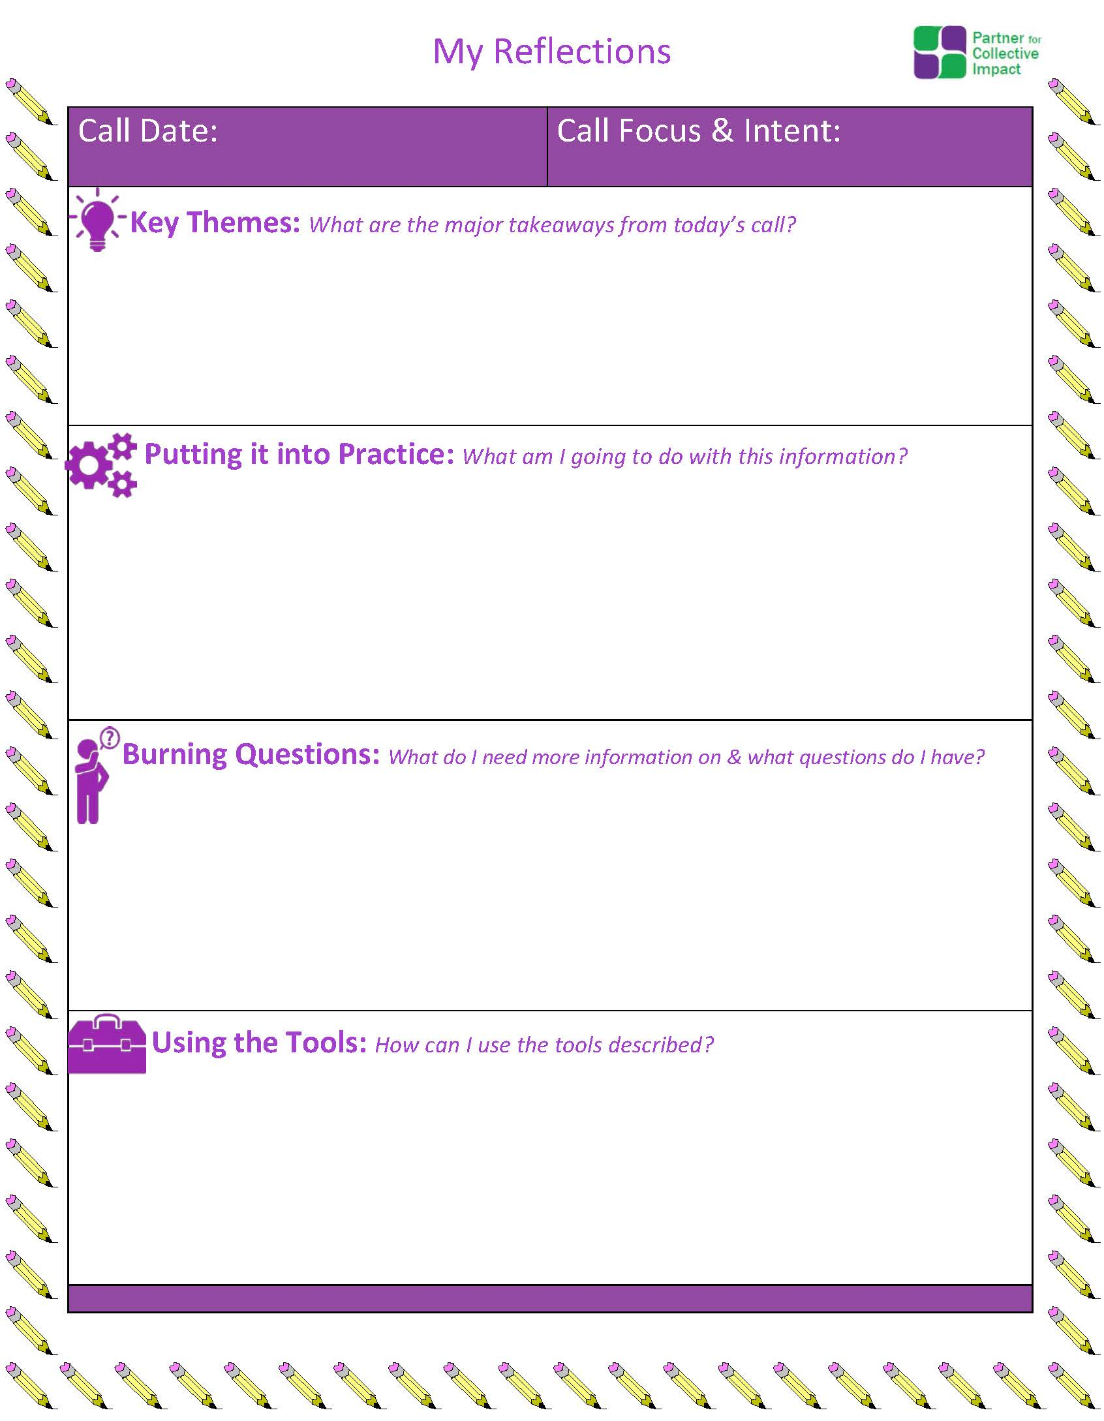
Reminder: Post Call Reflection Tool

Slide 8
Today’s Call Objectives
Increase understanding and share examples of mutually reinforcing activities
Introduce and discuss tools that will help your CAN/CI initiative begin to explore this condition
Discuss November’s face to face CI-PLN

Slide 9
Wrap-In
Revisiting Shared Measurement Systems

Slide 10
Follow-up from September Call
Shared Measurement
Identifies key measures that capture critical outcomes.
Establishes systems for gathering and analyzing measures.
Creates opportunities for “making-sense” of changes in indicators.
Allows participants in the group to hold each other accountable
Allows for adjustment to be made as results come in

Slide 11
Shared Measurement Tool

Slide 12
Cities Reducing Poverty – Change Indicators

Slide 13
Shared Measurement
Share one possible shared measurement that your CAN is using, or might use.
(Can be process, program, policy/system, population measure)

Slide 14
Overview of Mutually Reinforcing Activities

Slide 15
The Five Conditions of Collective Impact
Common Agenda
All participants have a shared vision for change including a common understanding of the problem and a joint approach to solving it through agreed upon actions
Collecting data and measuring results consistently across all participants ensures efforts remain aligned and participants hold each other accountable
Participant activities must be differentiated while still being coordinated through a mutually reinforcing plan of action
Consistent and open communication is needed across the many players to build trust, assure mutual objectives, and appreciate common motivation
Creating and managing collective impact requires a dedicated staff and a specific set of skills to serve as the backbone for the entire initiative and coordinate participating organizations and agencies
Shared Measurement
Mutually Reinforcing Activities
Continuous Communication
Backbone Support
11
Source: FSG

Slide 16
Collective Impact & Healthy Start
Common Agenda | Shared Measurement | Mutually Reinforcing Activities | Continuous Communication | Backbone Organization
Improve Perinatal outcomes Reduce racial and ethnic disparities Use community-based approaches to service delivery Facilitate access to comprehensive health and social services for women, infants and their families | Achieve Healthy Start Benchmarks Measurement Process and Approach | Improve Women’s Health Promote Quality Services Strengthen Family Resilience Achieve Collective Impact Increase Accountability | Audiences Media | Coordination Facilitation Administrative Support

Slide 17
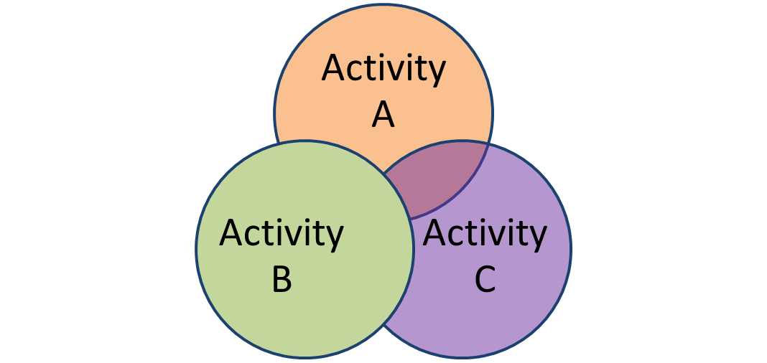
What are Mutually Reinforcing Activities?
The programs and services that are actually delivered to contribute to achieving the intended impact.
Collective Impact

Slide 18
Mutually Reinforcing Activities Include:
Agreeing on key outcomes;
Identifying opportunities for orchestration AND specialization;
Considering how activities might “join up.”

Slide 19
Why Mutually Reinforcing Activities?
Allows refinement and support of existing programs/activities towards impact
See whether existing programs should be linked/joined
Identify gaps for consumers/community members in services

Slide 20
Group Discussion
What experiences have you had in your community with programs/agencies/organizations coming together to work towards a common goal?

Slide 21
Group Discussion
What kind of an environment, or group dynamic, have you fostered to make this type of cooperation possible?

Slide 22
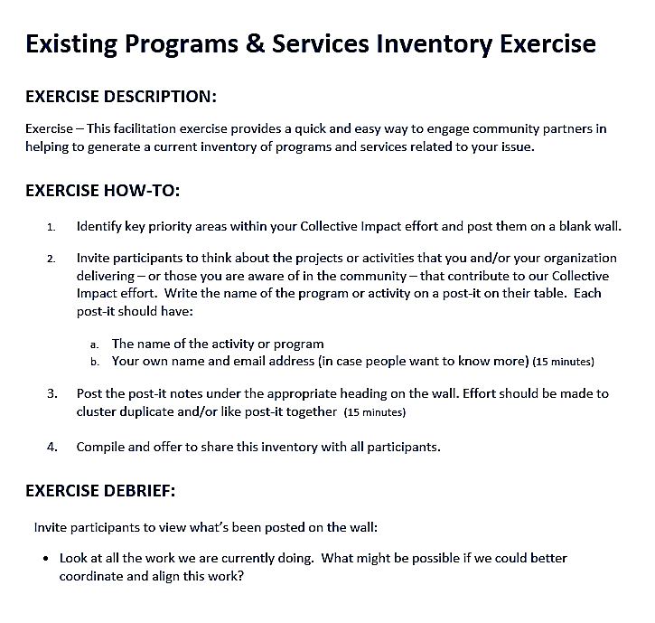
Tool: Existing Programs & Services Inventory

Slide 23
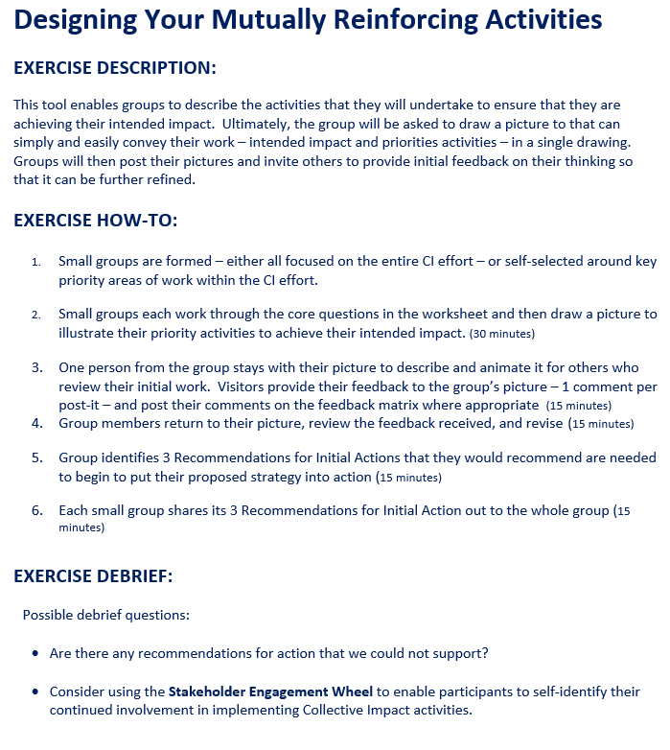
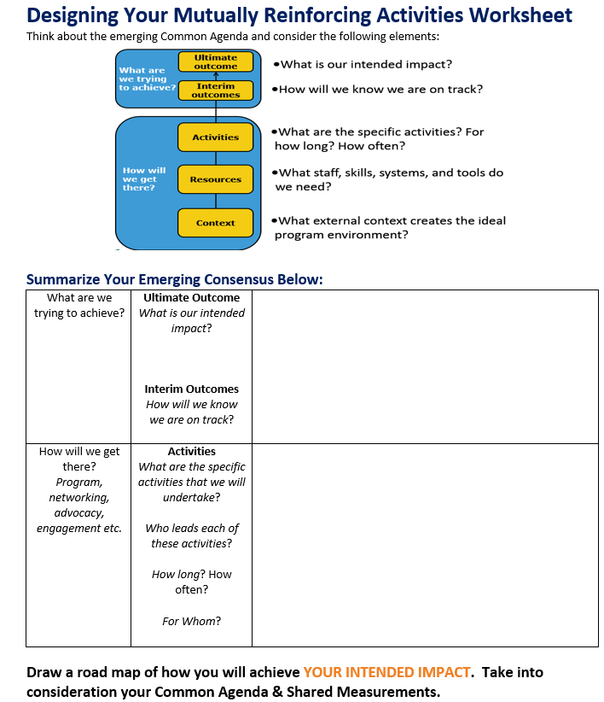
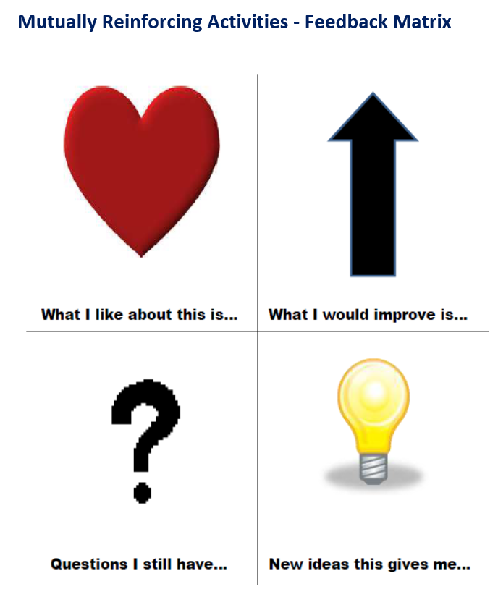
Tool: Designing Your Mutually Reinforcing Activities

Slide 24
Questions & Reflections?
Questions?
Thoughts or reflections?

Slide 25
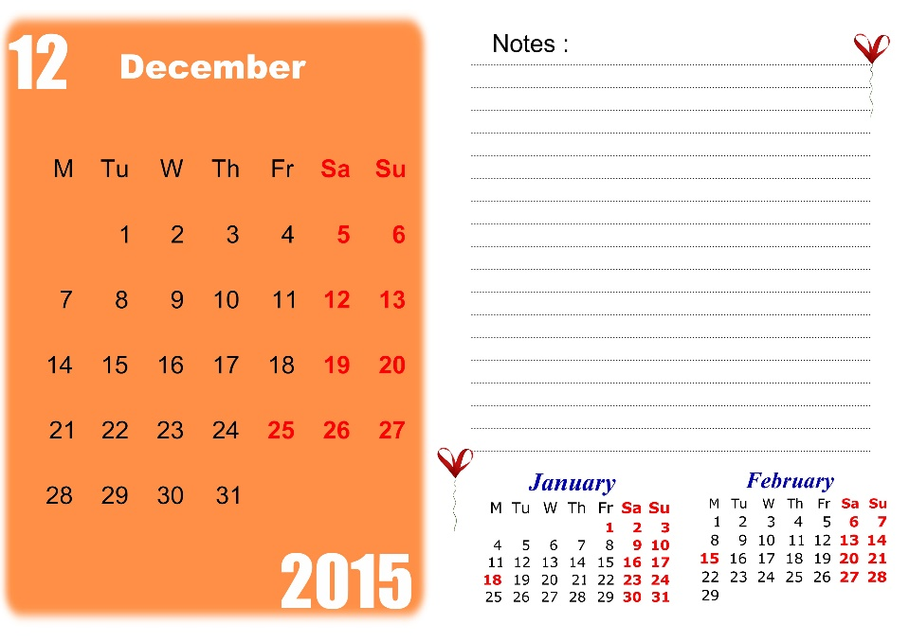
Wrap Up & Reminders
Our tools that we present are OPTIONAL resources, NOT required
December call will focus on CI Conditions: Continuous Communication & Backbone Functions
Materials from the call today will be shared in the forums in the coming days.
Please continue to use the forums to post questions and share about yourself and your CAN.
November’s CI-PLNs will take place face-to-fact during the HS Convention (Morning of Day 1, Nov. 16th)

Slide 26
Next CI PLN Meeting : Action Planning November 2015

