Slide 1
Applying Collective Impact to a Healthy Start CAN/CI Initiative
Peer Learning Network Call #3
August 2015

Slide 2
Agenda
Welcome
Today’s Objectives
Check-In
Time Management
Wrap- In
Revisit Pre-Conditions (Tools)
Overview Common Agenda
Share and Discuss Tools developing Common Agenda
Wrap-Up & Reminders
Update About Action Plans
Prepping for Next Call

Slide 3
CI-PLN Roadmap
1 | Building Relationships & PLN Goal Setting
2 | Exploring the CI Pre-Conditions
3 | Common Agenda
4 | Shared Measurement
5 | Mutually Reinforcing Activities
6 | Year 1 Collective Impact Implementation Plans
7 | Continuous Communications & Backbone Infrastructure
8 | Reflecting On Our Learning Journey

Slide 4
Today’s Call Objectives
Discuss your experience with applying tools presented during previous calls.
Learn about the Common Agenda CI condition.
Share tools for establishing your CAN’s Common Agenda

Slide 5
Creating a Safe Space
We agree to:
Listen with attention
Speak with intention
Contribute to the well-being of the group
We commit to:
Keep the stories we share in our community confidential
Listening with compassion and curiosity
Asking each other for what we need and offer what we can
Pausing, from time to time, to re-gather our thoughts or focus

Slide 6
Check-In

Slide 7
Time Management
Are you having challenges with integrating CI within your CAN from a time management perspective? (Chat in response or share verbally)

Slide 8
Wrap-In

Slide 9
Follow-up from July’s Call
PRE-CONDITIONS
Influential Champion(s)
Influential stakeholders that are already engaged in CAN
Who are the champions that should be engaged in your CAN?
Organizational and Individuals
Suggested Tool: Top 100 Partner Tool and Stakeholder Engagement Wheel Worksheet
Urgency of Issue
Conduct a formal or informal environmental scan of priority issues impacting your CAN
Suggested Tool: Assessing Our Community Context & Assessing Readiness for CI
Adequate Resources
Does your CAN have the necessary inputs to take action?
Suggested Tool: Assessing our CI Resources

Slide 10
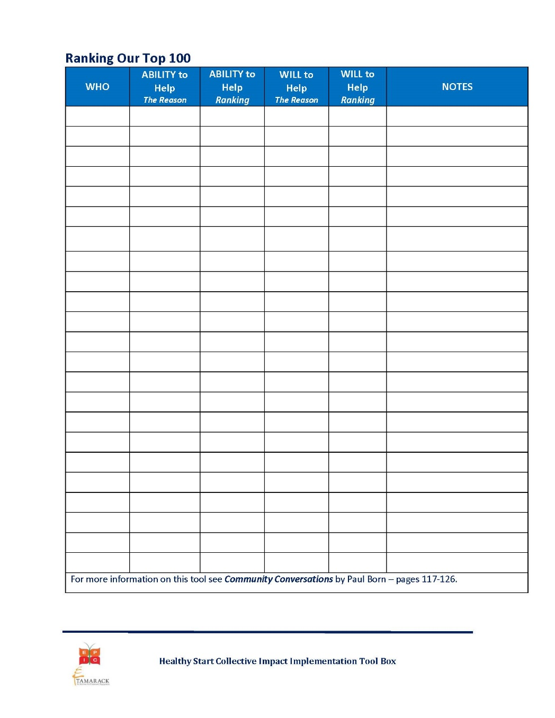
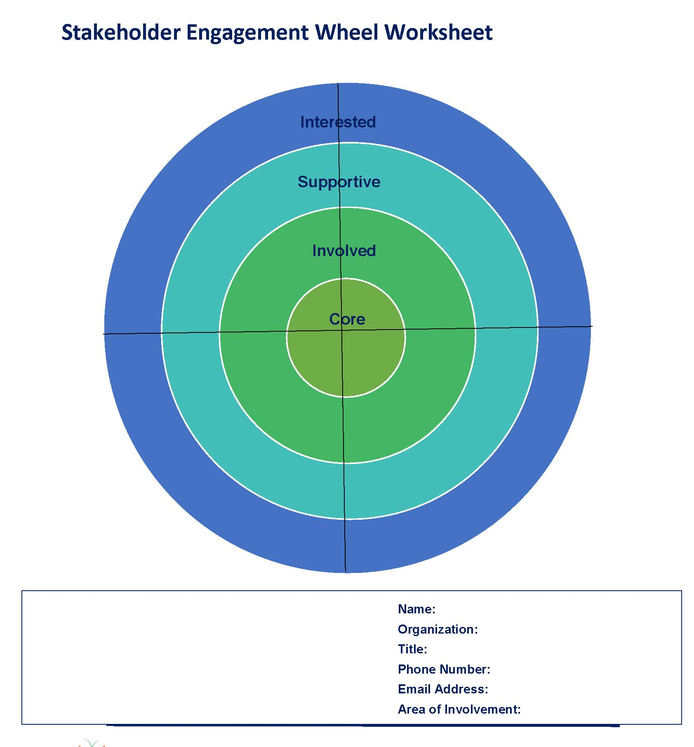
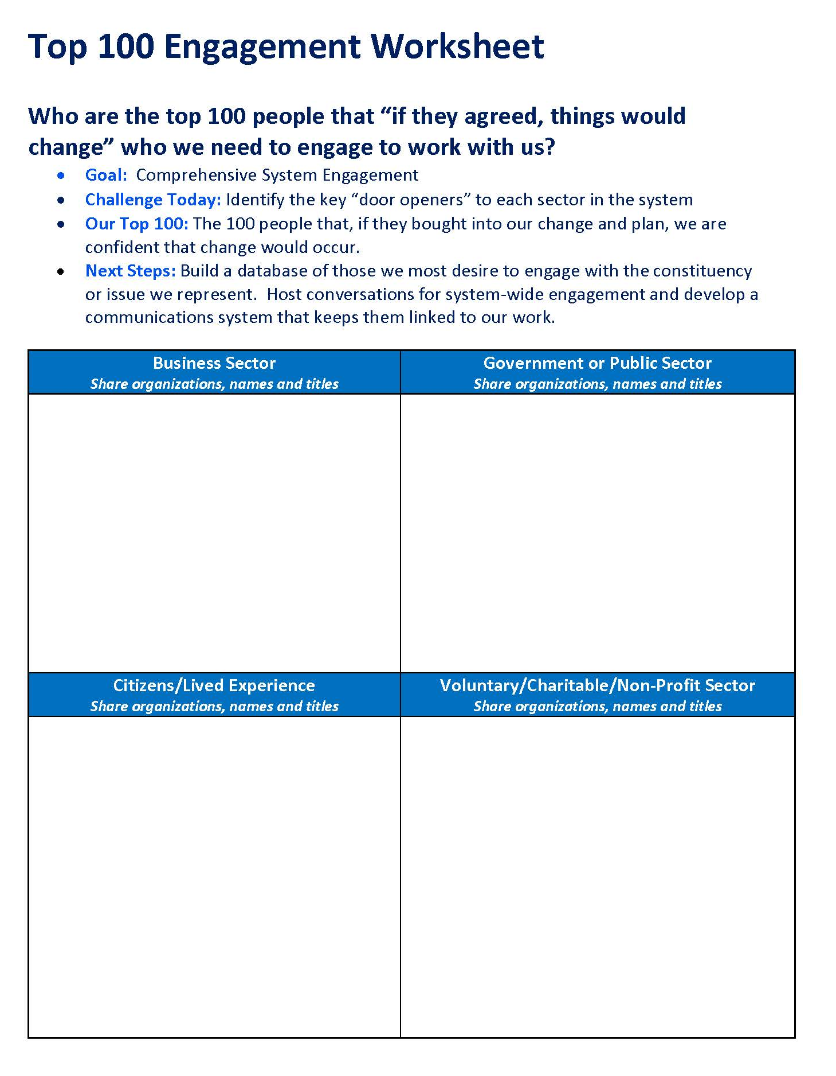
Tools – Influential Champion(s)
Suggested Tool: Top 100 Partner Tool

Slide 11
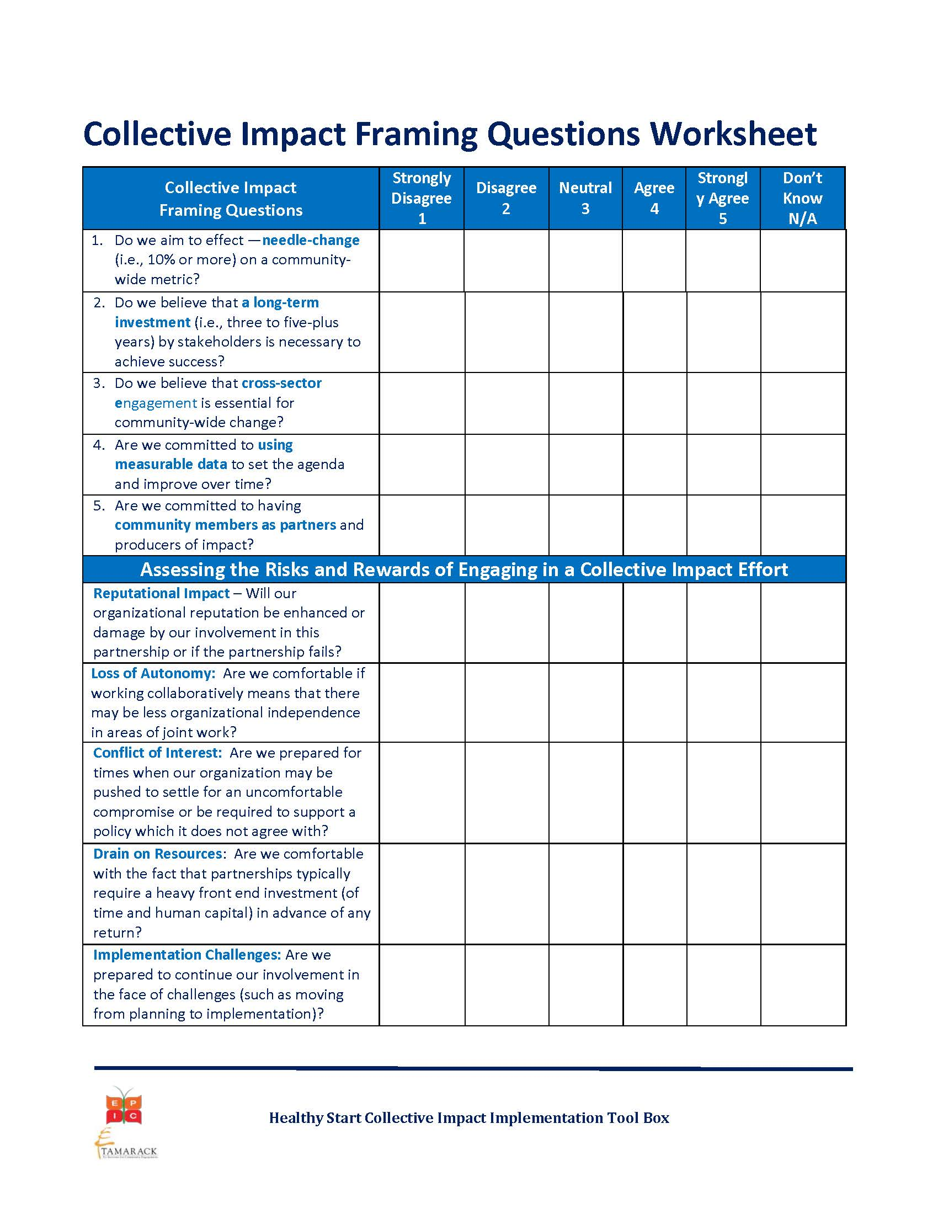
Tools – Urgency of Issue

Slide 12
Tools – Adequate Resources

Slide 13
Overview of Common Agenda & Related Tools

Slide 14
The Five Conditions of Collective Impact
Common Agenda
All participants have a shared vision for change including a common understanding of the problem and a joint approach to solving it through agreed upon actions
Ex. HS Related Common Agenda
The Power of an Affirmation Statement…
“Make Hamilton the best place to raise a child”
Improve Perinatal outcomes
Reduce racial and ethnic disparities in birth outcomes
Facilitate access to comprehensive health and social services for women, infants and their families
OTHERS???
11
Source: FSG

Slide 15
Common Agenda
Define the challenge to be addressed.
Acknowledge that a collective impact approach is required.
Establish clear and shared goal(s) for change.
Identify principles to guide joint work together.

Slide 16
Collective Impact – Framing Questions
Do we aim to effect―needle- change (i.e., significant and measurable progress) on a community-wide metric?
Do we believe that a long-term investment (i.e., three to five-plus years) by stakeholders is necessary to achieve success?
Do we believe that cross-sector engagement is essential for community-wide change?
Are we committed to using measurable data to set the agenda and improve over time?
Are we committed to having community members as partners and producers of impact?

Slide 17
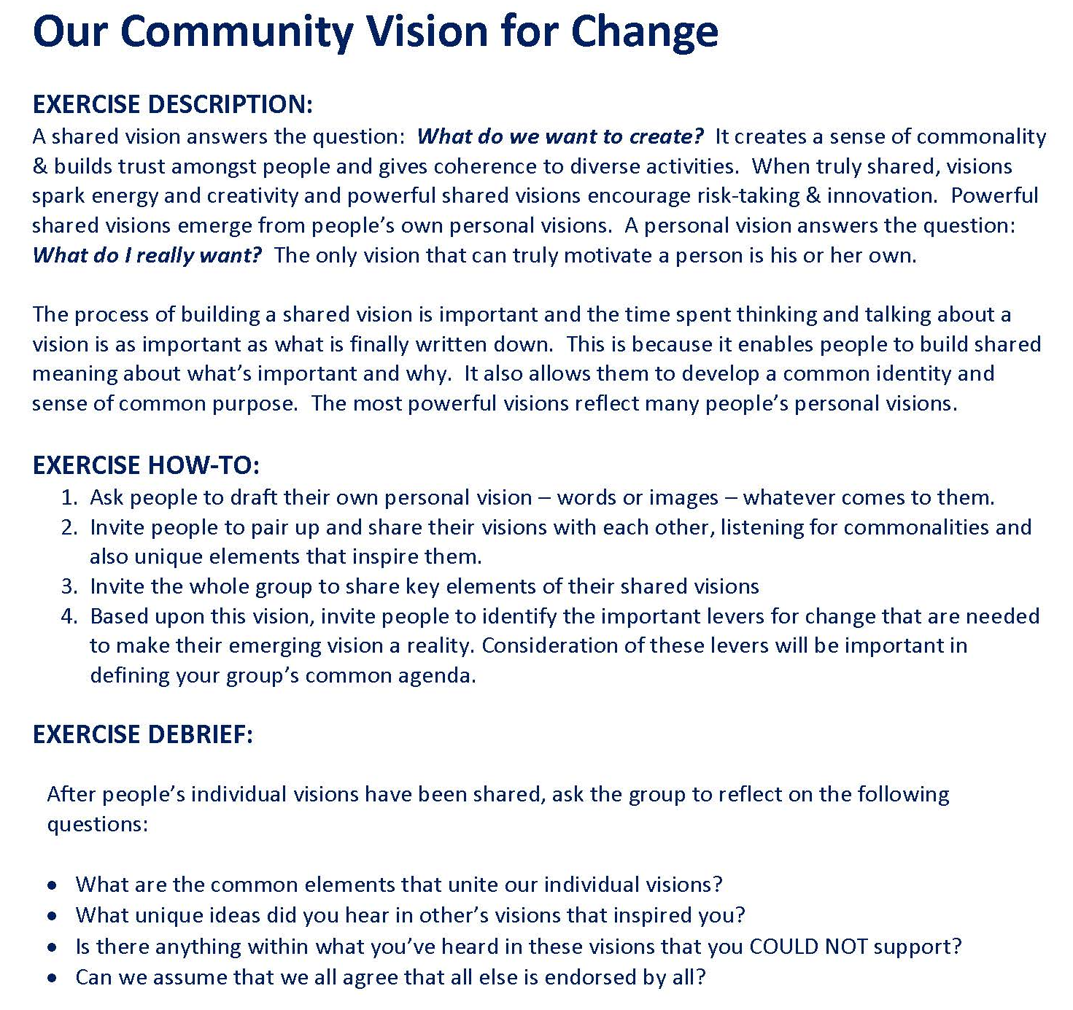
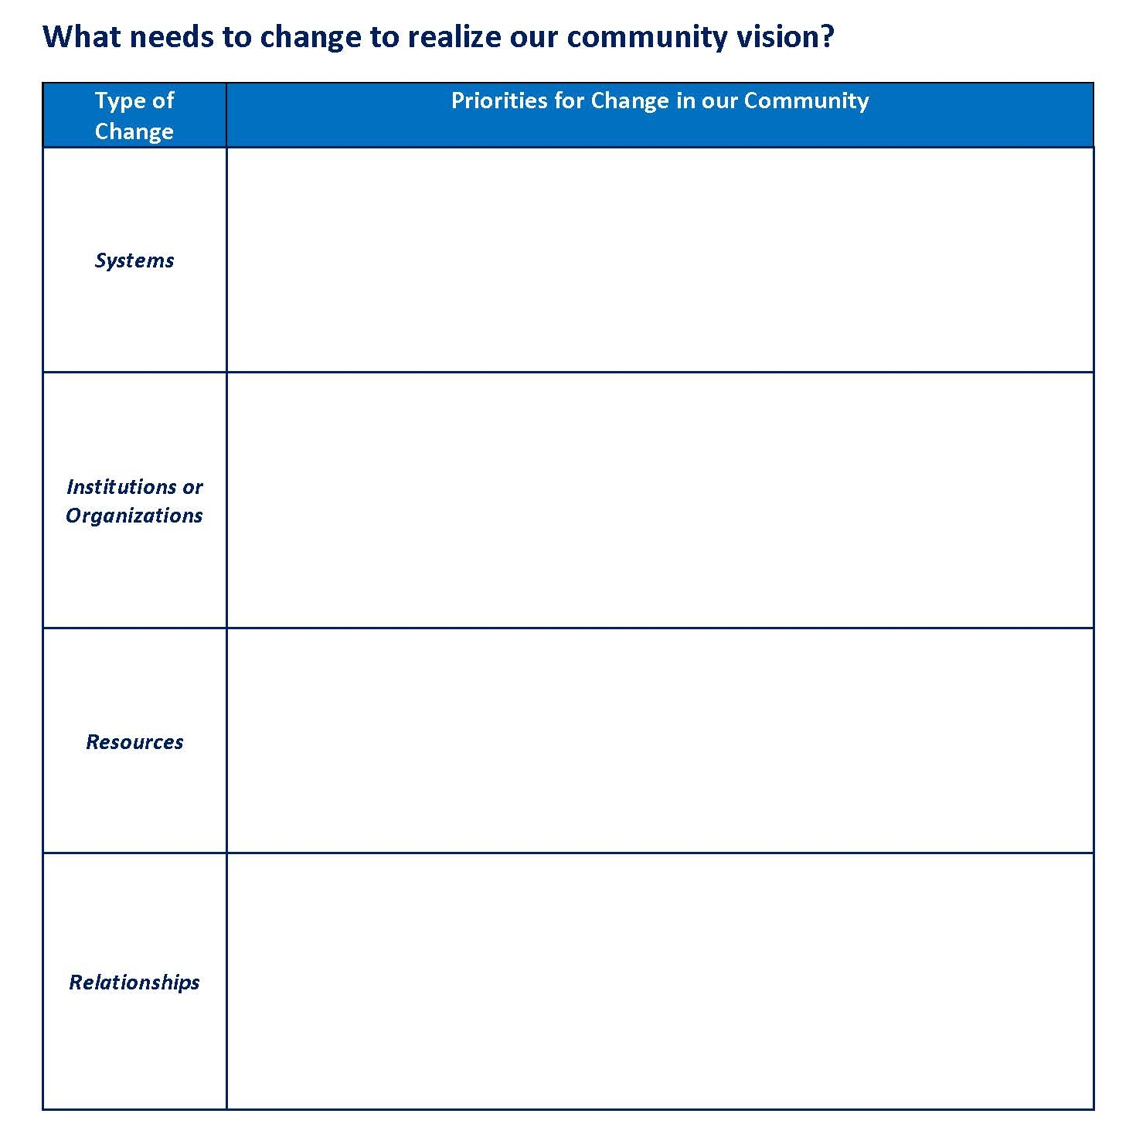
Tools – Common Agenda

Slide 18
Tools – Common Agenda

Slide 19
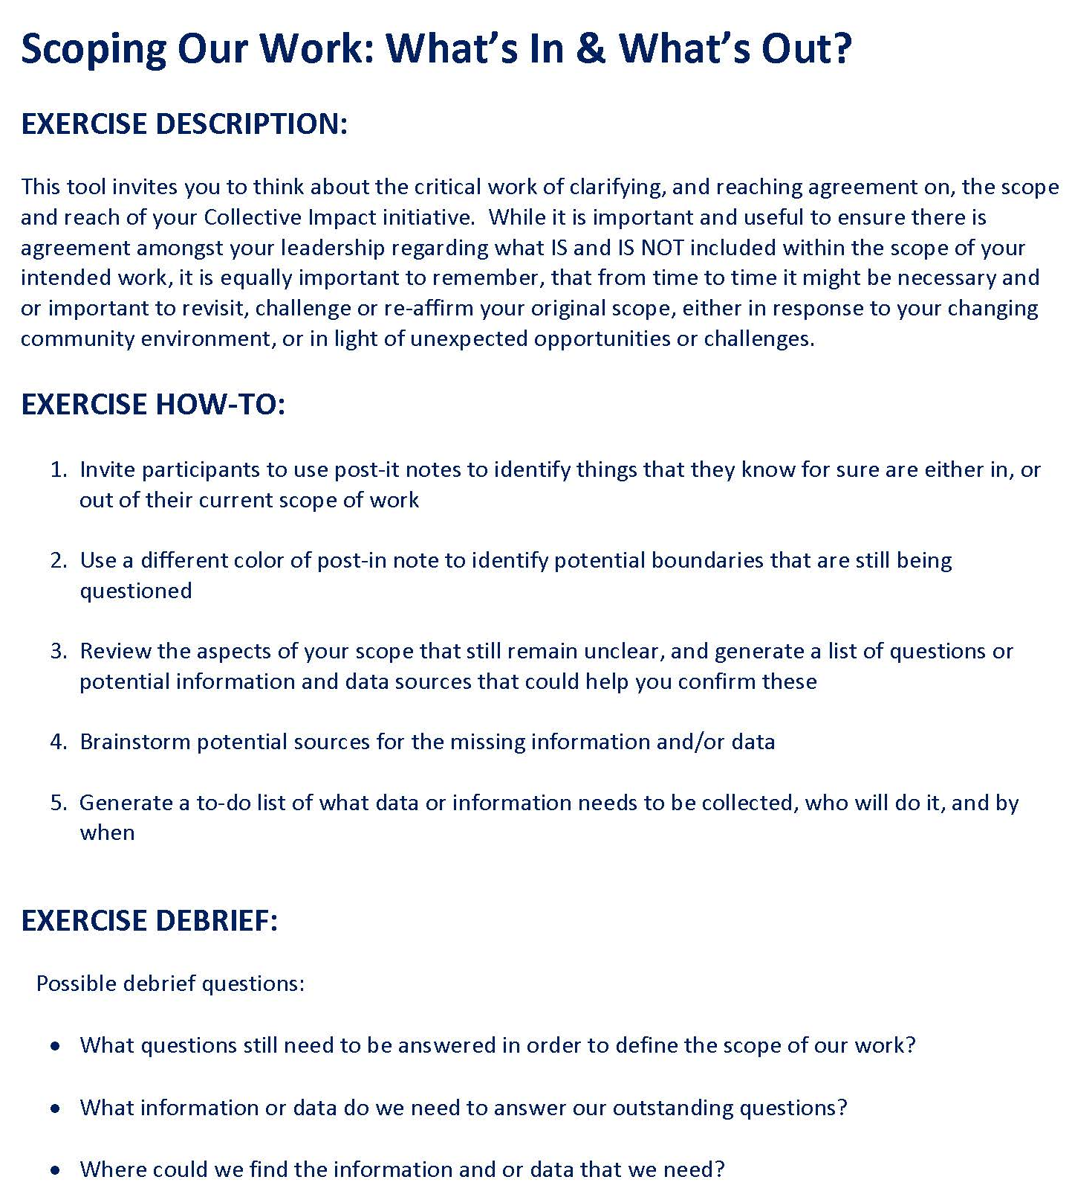
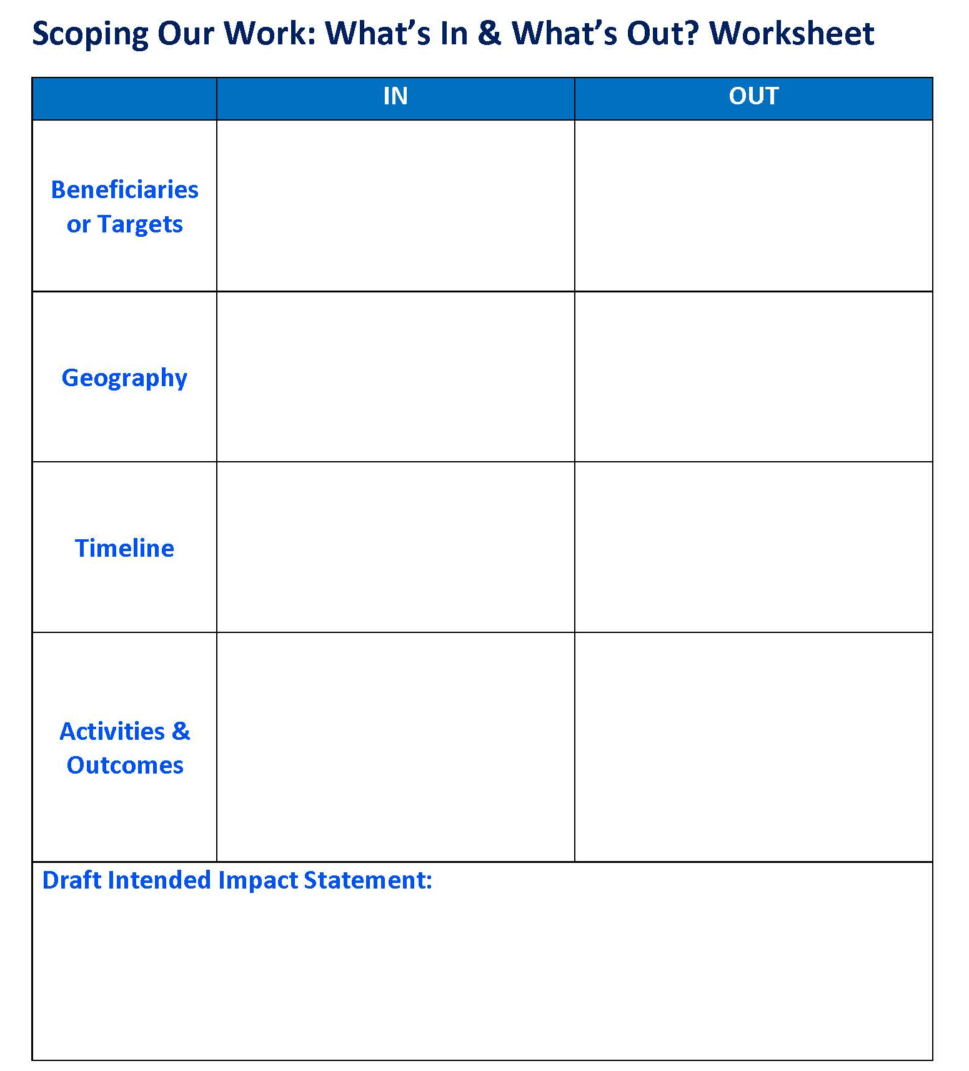
Tools – Common Agenda

Slide 20
Other Examples?
Have you used other tools/processes to get at your common agenda?
Do you find these tools helpful or are you needed more?

Slide 21
Questions & Reflections?
Questions?
Thoughts or reflections?

Slide 22
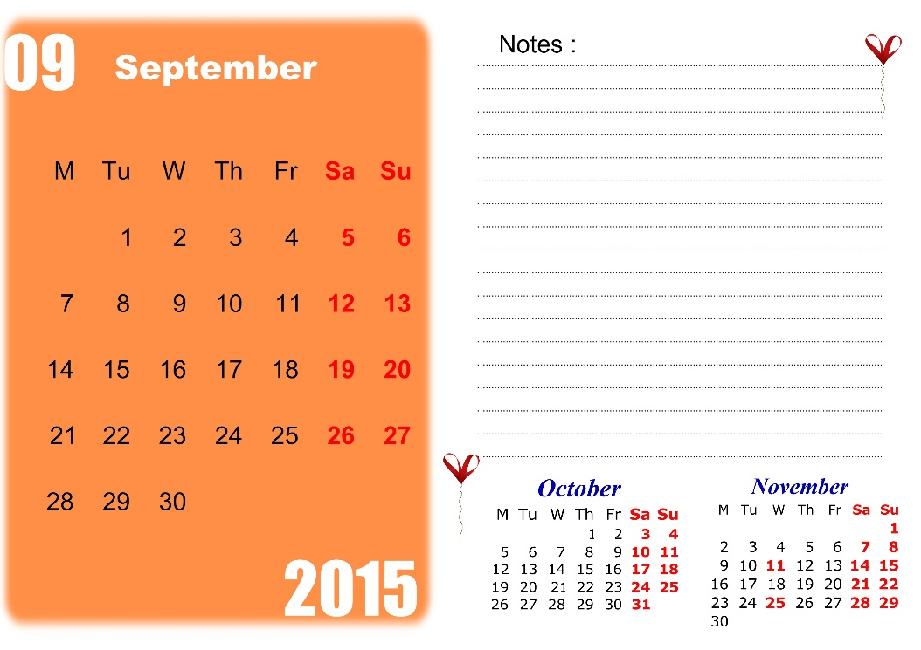
Wrap Up & Reminders
November’s CI-PLNs will take place face-to-fact during the HS Convention (Morning of Day 1, Nov. 16th)
Will likely focus on CI Action Plans
We will have more details to share about this and the Action Plan template next month
Next call will feature shared measurement!
Materials from the call today will be sent out in the coming days.
Please continue to use the forums to post questions and share about yourself and your CAN.

Slide 23
Next CI PLN Call: Shared Measurement September 2015

